Slide 1
AMA National Alcohol Summit FASD
Dr Richard Kidd
Deputy Chair AMA Council General Practice
Notes:
Good morning. Thank you for the opportunity to speak to you this morning as a GP and AMA representative.

Slide 2
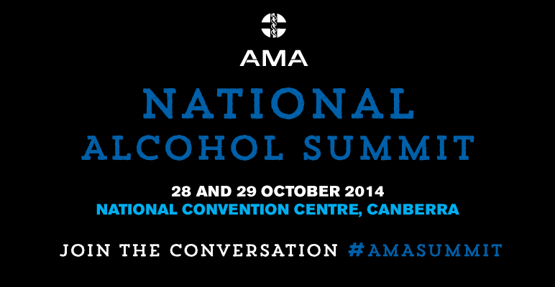
AMA Advocacy harmful alcohol use
Notes:
The AMA has a strong history of advocacy and awareness-raising about harmful alcohol use. Today I want to outline the key challenges and priorities we see in this area of policy, what can be done to reduce the harms of alcohol use, and – in particular – how this relates to efforts to prevent, diagnose and manage FASD in Australia.
The AMA has been a consistent public voice advocating policies to tackle the various factors contributing to the harmful consumption of alcohol. This has included highlighting the extent and impacts of alcohol marketing targeting young people, and lobbying governments to address the availability, affordability and warning labelling of alcohol.

Slide 3
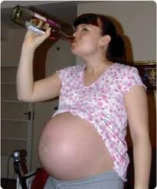
Alcohol related harm in pregnancy
Notes:
In addition to the lobbying for changes to government policies and regulations around alcohol and alcohol marketing, the AMA recognises that health professionals have an important role to play in preventing alcohol-related harms among their patients. In particular, a key priority is addressing the consumption of alcohol by pregnant women.

Slide 4
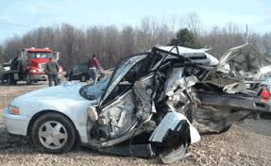
Alcohol related road death & injury
Notes:
As a GP and with other doctors who are often at the front-line in dealing the effects of excessive drinking, I and my colleagues in the AMA come to this issue with a very vivid personal awareness of the harms that alcohol can cause. And, in large part, it is this awareness that motivates the AMA to put so much energy into policy and advocacy to reduce the harms of excess alcohol use.

Slide 5
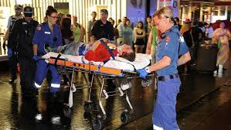
Alcohol related violence
Notes:
Recently, much of the public and media’s focus on alcohol was captivated by the tragic instances of alcohol-related violence in Sydney.

Slide 6
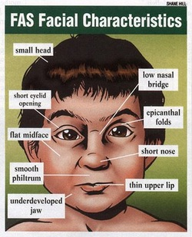
Foetal Alcohol Spectrum Disorder
Notes:
The consequences of drinking alcohol during pregnancy can be devastating. It has been linked to Foetal Alcohol Spectrum Disorder (FASD), preterm birth, low birth weight and increased risk for sudden infant death syndrome. FASD is the most common preventable cause of birth defects in Australia, and has profound lifelong consequences, impacting not only on individuals but also on families, the health care system, the social service system, the criminal justice system, and the education and employment systems.

Slide 7
NHMRC Guidelines:
For women who are pregnant or planning pregnancy, not drinking is the safest option
For women who are breastfeeding, not drinking is the safest option.
Notes:
In 2009, the National Health and Medical Research Council’s (NHMRC’s) Guidelines to Reduce the Health Risks from Drinking Alcohol were updated and the information on alcohol and pregnancy was revised. The revised Alcohol Guidelines specify that: Maternal alcohol consumption can harm the developing foetus or breastfeeding baby.
• For women who are pregnant or planning pregnancy, not drinking is the safest option.
• For women who are breastfeeding, not drinking is the safest option.2
Up until now, promotion of the revised guidelines has been limited and ad hoc, and there has been no national program to promote awareness of these guidelines either to health professionals or to the wider community.

Slide 8
Guidelines need promoting
Nearly 50% of women consumed alcohol before knowing they were pregnant
19.5% consumed alcohol knowing they were pregnant
> 45% health professionals not familiar with NHMRC guidelines
Notes:
The need to promote understanding of the guidelines and the risks of alcohol during pregnancy is reflected in the proportion of women who consume alcohol during pregnancy:
nearly half of all women consumed alcohol while pregnant before knowledge of their pregnancy;
Around 1 in 5 (19.5%) consumed alcohol while pregnant after knowledge of their pregnancy;
A survey of health professionals undertaken by FARE in 2013 found that, while most were aware of the NHMRC Guidelines, more than two in five (45%) were not familiar with the content.

Slide 9
Women Want To Know Project
FARE / AMA …
Information for health professionals on pregnancy and alcohol
Notes:
In recognition of these facts, the Women Want to Know Project was established to encourage health professionals to routinely discuss alcohol and pregnancy with women and to provide advice that is consistent with the NHMRC’s Alcohol Guidelines. This is the first national project to promote the revised maternal alcohol consumption guideline among health professionals. Women Want to Know was developed by the Foundation for Alcohol Research and Education (FARE) in collaboration with the AMA and other leading health professional bodies across Australia, and is supported by funding from the Australian Government under the Substance Service Delivery Grants Fund. The AMA’s contribution to the project has included representation on the working group overseeing the project; inviting feedback from AMA members on the key barriers and enablers to discussing alcohol with patients; supporting the distribution of a survey through the AMA’s GP networks; and the participation of the AMA President and Dr Barri Phatarfod in filmed interviews and in scripted scenarios for a CPD module

Slide 10

Women want to know project:
97% of Australian women want to be asked about alcohol use during pregnancy
Notes:
Health professionals can play a key role in informing women about the effects of alcohol. The AMA recognises that routine screening is a vital element in preventing drinking during pregnancy; the leading cause of preventable birth defects. Because most women seek prenatal care during their first trimester, this is an opportune time for GPs like me, Obstetricians, Midwives, Aboriginal Health Workers and others to help them make the changes necessary for a healthy pregnancy.
It is important for health professionals to know that conversations about alcohol with women who are pregnant and planning a pregnancy are wanted, welcome and worth their time. Research shows that women are willing to make changes to their lives during pregnancy to provide the best for their babies, and conversations with health professional can potentially prevent a child being born with FASD. 97% of Australian women want to be asked about alcohol use during pregnancy and consider health professionals to be the best source of information about alcohol use during pregnancy and trust the advice they give.
Women Want to Know involves two main components: Resources to support health professionals to discuss alcohol use and pregnancy with women; and Accredited training to provide health professionals with information and tools to enable them to discuss alcohol and pregnancy with women.

Slide 11
The 5 As
Ask all women of child bearing age and pregnant women about their alcohol use
Assess and record the level of risk of women’s alcohol intake
Advise all women that no alcohol is the safest choice when pregnant or planning a pregnancy
Assist women to stop or reduce alcohol consumption
Arrange for further support
Notes:
GPs and other health professionals can positively influence a woman’s choices about alcohol during pregnancy and help her have the healthiest baby possible.
One easy way to discuss alcohol consumption with pregnant women or women planning pregnancy is to use the 5As. Used extensively in smoking cessation, this evidence-based framework helps structure a conversation that is appropriate to the patient. The 5As are:
ASK all women of childbearing age and pregnant women about their alcohol use. This is important as close to 50% of all pregnancies are unplanned.
ASSESS and record the level of risk of women’s alcohol consumption using tools such as AUDIT-C.
ADVISE all women that: No alcohol is the safest choice when pregnant or planning pregnancy. An amount of alcohol that is safe for the foetus has not been determined. Women who have consumed alcohol in pregnancy should be advised that: The level of risk to the foetus is hard to predict and the risk of harm to the foetus is likely to be low if only small amounts of alcohol have been consumed; Stopping drinking at any time in the pregnancy will reduce the risk to the foetus; and Any concerns about the baby’s development should be raised with a health professional.
ASSIST women to stop or reduce alcohol consumption through: Positive reinforcement for women who are already abstaining; Advising on the consequences of alcohol exposure to the foetus; Encouraging women to seek the support of their partner and loved ones in abstaining; and Conducting brief intervention or motivational interviewing with the aim of supporting women to abstain, and where this is not possible, to reduce alcohol intake and avoid intoxication.
ARRANGE for further support for women by planning additional consultations or by referral to specialist services and support groups.

Slide 12
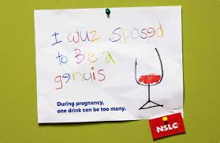
National Foetal Spectrum Disorder Action Plan
Notes:
This project is part of the Government’s recent announcement to fund the National Foetal Alcohol Spectrum Disorder Action Plan. The AMA commend the Government’s commitment and, as part of the strategy that has been announced, we are also pleased to see a specific focus on building on programs such as the Women Want to Know Project and providing education and support to medical professionals in preventing FASD.
While this is a welcome and important first step, more needs to be done if we are to prevent and address FASD in Australia. For too long, the issue of FASD has been neglected in Australia, with little or no support in its prevention, diagnosis and early intervention or management. The AMA hopes to see further funding committed to addressing the full range of measures that this issue warrants.

Slide 13
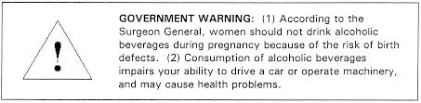
Warning labelling
Notes:
We also urge the Government to reconsider its recent decision to not mandate pregnancy warning on alcohol products, despite the evidence that effective health warning labels can raise awareness about the risks of consuming alcohol during pregnancy.
The United States has this mandated Surgeon General’s warning on alcoholic beverages and ones like it since 1988.
South Africa has mandated warnings including “Drinking during your pregnancy can be harmful to your unborn baby”.
The Russian Federation has mandated “Alcohol is not for children and teenagers up to age 18, pregnant & nursing women…”
Thailand has mandated warnings including “Liquor drinking is harmful to you and destroys your family”

Slide 14
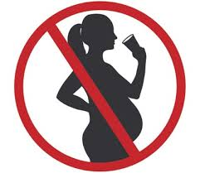
Warning label - France
Notes:
France has the mandated warning label “Drinking alcoholic beverages during pregnancy even in small quantities can have grave / serious consequences for the health of the baby” OR use the government-issued symbol showing a diagonal line being superimposed on an image of a pregnant woman holding a glass
Japan has a voluntary warning label that “Drinking alcohol during pregnancy or nursing may adversely affect the development of your foetus or child”
China has voluntary recommended warning labels that “Over drinking is harmful to health” and “Pregnant women and children shall not drink”.
Many other countries have mandated warning labels about dangers and adverse health effects but don’t specify pregnancy or breast feeding

Slide 15

Drinking culture:
Notes:
Alcohol consumption during pregnancy does not occur in isolation, but is a result of a broader drinking culture that encourages and reinforces alcohol consumption through the excessive availability, affordability and marketing of alcohol. FASD is one of a number of harms attributable to alcohol – it is part of the wider and complex issue of alcohol use in the community. The AMA believes that any attempt to tackle FASD must occur within a comprehensive and whole-of-government approach to reduce harmful drinking across the population.

Slide 16
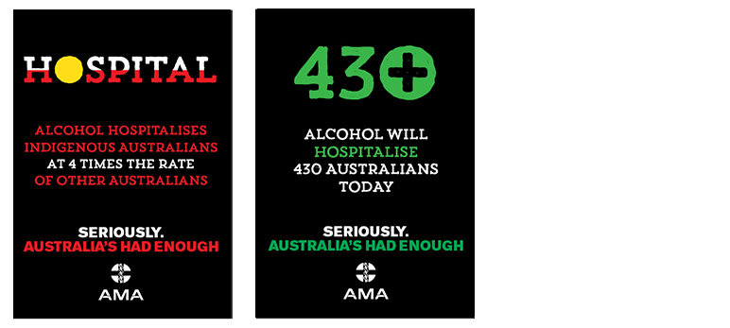
Alcohol hospitalises how many?
Notes:
FASD is not unique to any group or community in Australia, and the AMA supports a population wide approach to alcohol use and to FASD more specifically.
However, we also recognise that there are certain populations and regions who experience a disproportionate burden of harm from alcohol including Indigenous communities. Alcohol hospitalises indigenous Australians at 4 times the rate of other Australians. Today and every day alcohol hospitalises 430 Australians. Targeted approaches as well as population-wide measures are an important feature of any effective strategy.

Slide 17
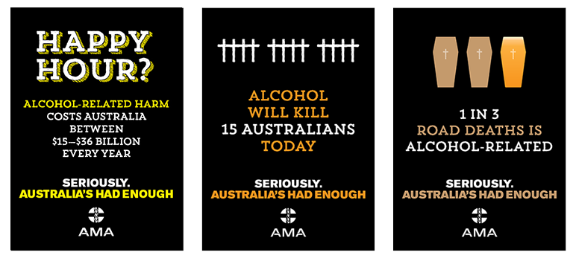
Alcohol costs how much?
Notes:
As well as hospitalisations alcohol will kill 15 Australians today, 1 in 3 road deaths is alcohol related and alcohol related harm costs Australia up to $36 Billion dollars every year.

Slide 18
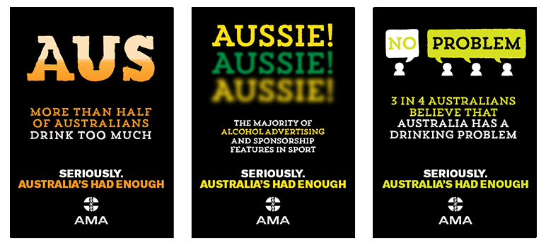
Alcohol is advertised mainly in sport!
Notes:
And yet we still see the majority of alcohol advertising in sport, normalising the excessive drinking culture to our children and young adults, setting up another generation for alcohol related harm through drinking in pregnancy resulting in too many preventable FASD babies, risky drinking behaviour resulting in alcohol related violence, too many hospitalisations of indigenous Australians at 4 times the rate of other Australians and too many deaths.
So, if there is to be an effective sustained response to alcohol use and associated harms such as FASD, it is vital we move beyond ad hoc and piecemeal measures.
Leadership and commitment at the Federal level is vital if this is be achieved. The harms of excess alcohol use are comprehensive, and their prevalence is far reaching. Australia’s doctors believe that the solutions must be equally comprehensive and far reaching.
In addition we do not believe that such solutions are likely to be reached if governments continue to defer the influence and interests of the alcohol industry. The alcohol industry consistently projects itself as seeking a partnership with governments under the guise of encouraging community education and responsible drinking. Yet the alcohol industry has consistently opposed regulation or effective measures that have been demonstrated to reduce alcohol-related harms.

Slide 19
AMA Position Statement: Alcohol Consumption and Alcohol-related Harms - 2012
https://ama.com.au/position-statement/alcohol-consumption-and-alcohol-related-harms-2012
Notes:
The AMA urges Parliamentarians to examine the evidence of what works and support the comprehensive set of policy measures that the AMA recommends, and to start making the policy and regulatory decisions needed to change our harmful drinking culture.

