Slide 1
Branding with mobile social media
Nicholas Carah, University of Queensland. @nnniccc
n.carah@uq.edu.au
What does it mean to live in a society where media demand our participation?
What do we do with media?
How do media watch and respond to us?

Slide 2
Interplay between cultural life, mobile media and branding.
Smartphones. Facebook. Instagram. Snapchat.
More images.
More mobile.
More real world.
More participation.
More individual curation.
More data.
More responsive.
More customised.
Less visible to public scrutiny.

Slide 3
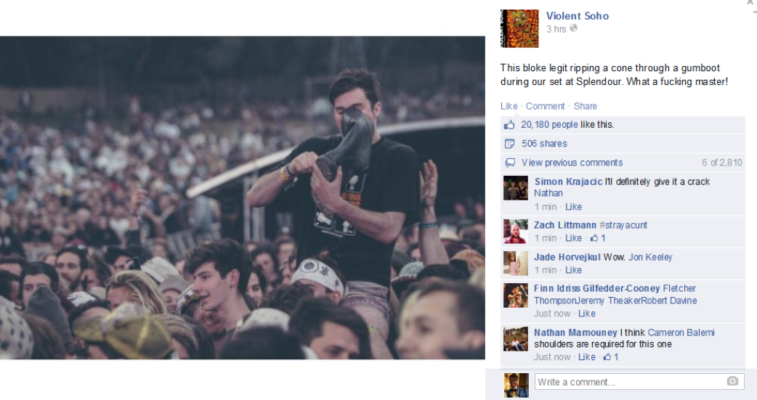
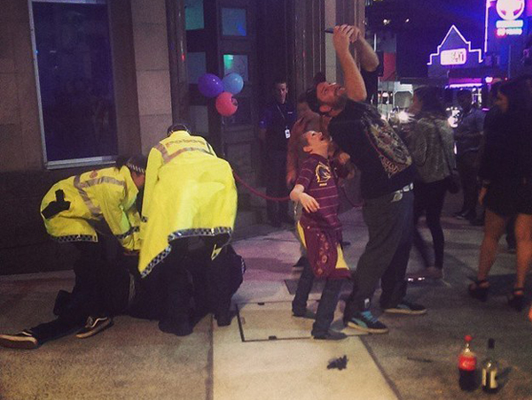
Image machines.
Interplay between people, devices, and networks.
The human capacity to create, communicate and affect one another.
The capacity of media devices to translate everyday life into content data.
The capacity of networks to watch and respond.

Slide 4
BIG PLAYERS,
BIG EXPERIMENTS.

Slide 5
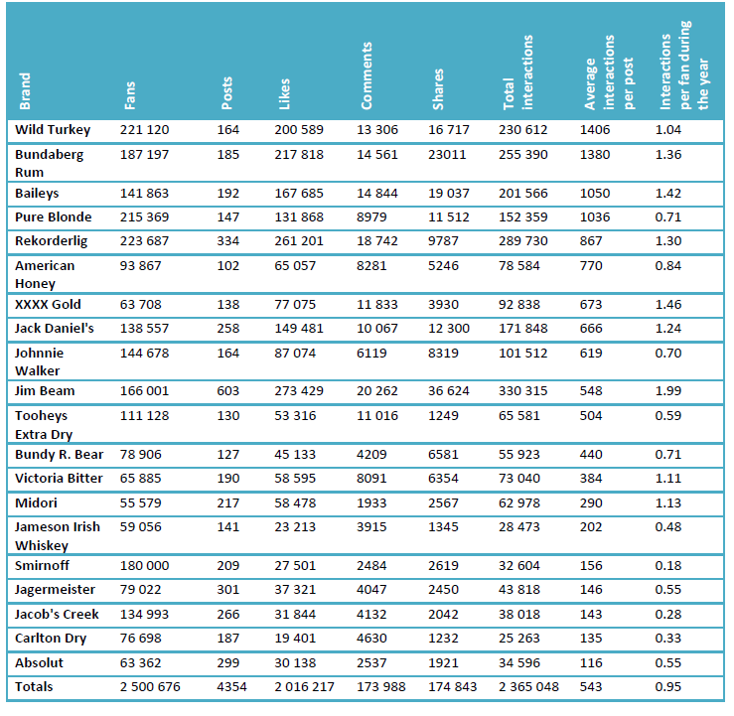

Slide 6
Transition to global pages: capacity to experiment?
Brand | Australian Facebook fans (2012) | Global Facebook fans (2014)
Smirnoff | 8.9 million | 11.2 million
Johnnie Walker | 146 678 | 10.3 million
Bacardi | 17 662 | 7.9 million
Absolut | 63 362 | 5.1 million
Jagermeister | 79 022 | 3.5 million
Jim Beam | 166 000 | 2 million

Slide 7
Alcohol brands’ Australian Facebook pages
Brand | Number of fans (2012) | Number of fans (2014) | Growth
Jacob’s Creek | 134 993 | 439 338 | 225%
Rekoderlig | 223 687 | 316 156 | 41%
Wild Turkey | 221 120 | 308 515 | 39%
Bundaberg Rum | 187 197 | 275 722 | 47%
Canadian Club | 45 951 | 239 026 | 420%
American Honey | 93 867 | 157 267 | 67%
Carlton Dry | 76 698 | 142 690 | 86%
XXXX Gold | 63 708 | 115 853 | 81%
Rosemount Estate | 1227 | 61 510 | 4883%
Strongbow | 16 550 | 41 938 | 153%

Slide 8
Experiments with media
“Facebook has been a natural fit for us… Working in such close collaboration will allow us to really maximise consumer participation at scale in our campaigns, particularly in emerging markets.
We are already seeing real value from our work in this space. Over 950 Diageo marketers around the world have now been trained in Facebook boot camps to build their social media capabilities and we are seeing significant returns on investment across a number of brands. We expect this new way of working to deliver even more commercial value for Diageo.”
- Andy Fennell, chief marketing officer, Diageo.

Slide 9
PROMPTING CONSUMERS TO SAY THINGS BRANDS CANNOT

Slide 10
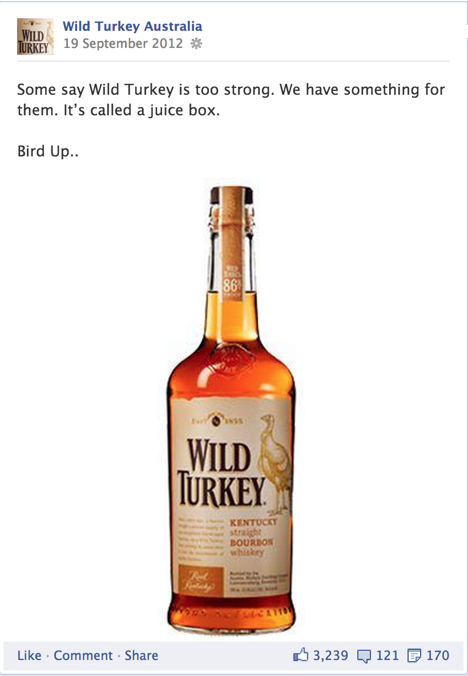
Wild Turkey say:
‘Some say Wild Turkey is too strong. We have something for them. It’s called a juice box. Bird Up…’
3239 likes, 121 comments, 170 shares.
Fans reply:
‘we call those people soft cock blouse wearing poodle walkers’
‘too strong? grow some balls !!!!!!!!!!!’
‘not for girly men’

Slide 12
AFFINITY:
TUNING INTO SOCIAL MEDIA ALGORITHMS.

Slide 13
Friday is the most common day to post. Most posts are between 3pm and 6pm.
Brands average 543 interactions per post, when they post time and event specific content that rises to an average of 792 interactions.

Slide 14
‘118 minutes till Rum O’Clock. Hang in there team’

Slide 15
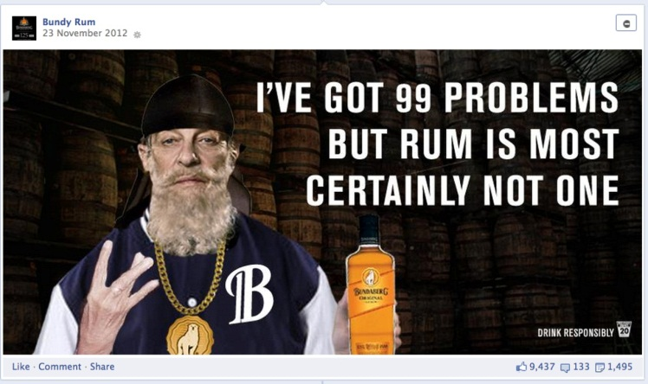
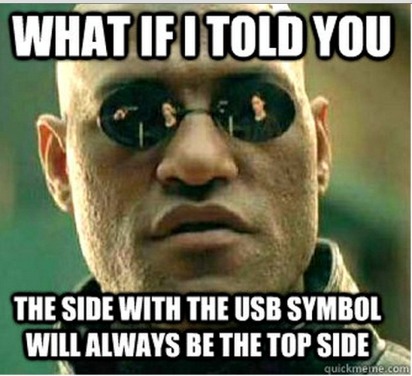
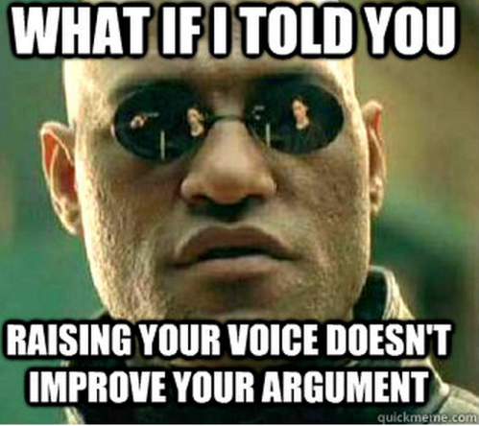

Slide 16
GOING MOBILE & CONFIGURING REAL WORLD PARTICIPATION

Slide 17
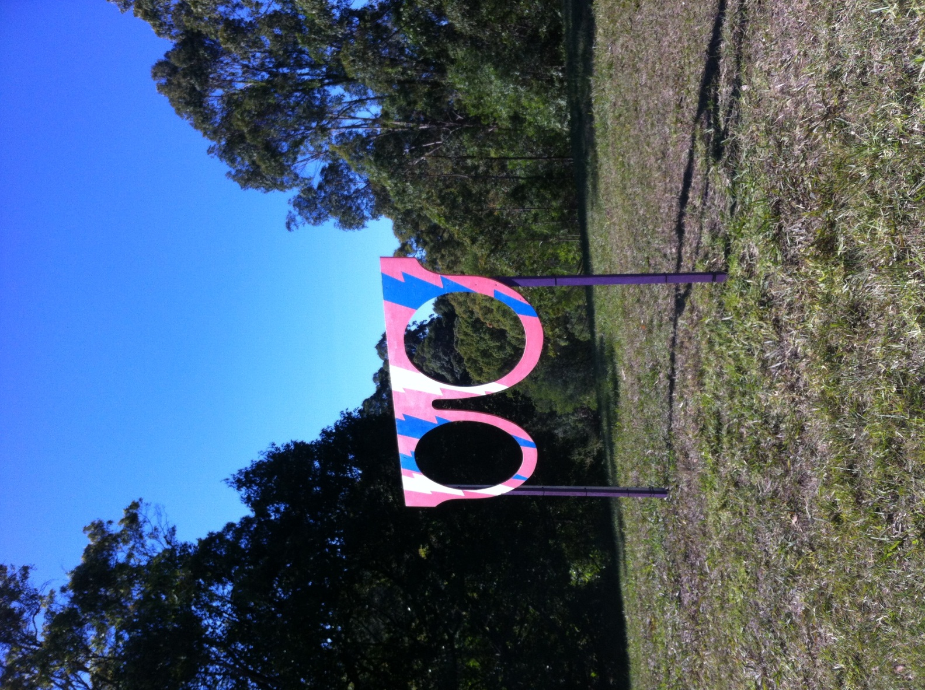
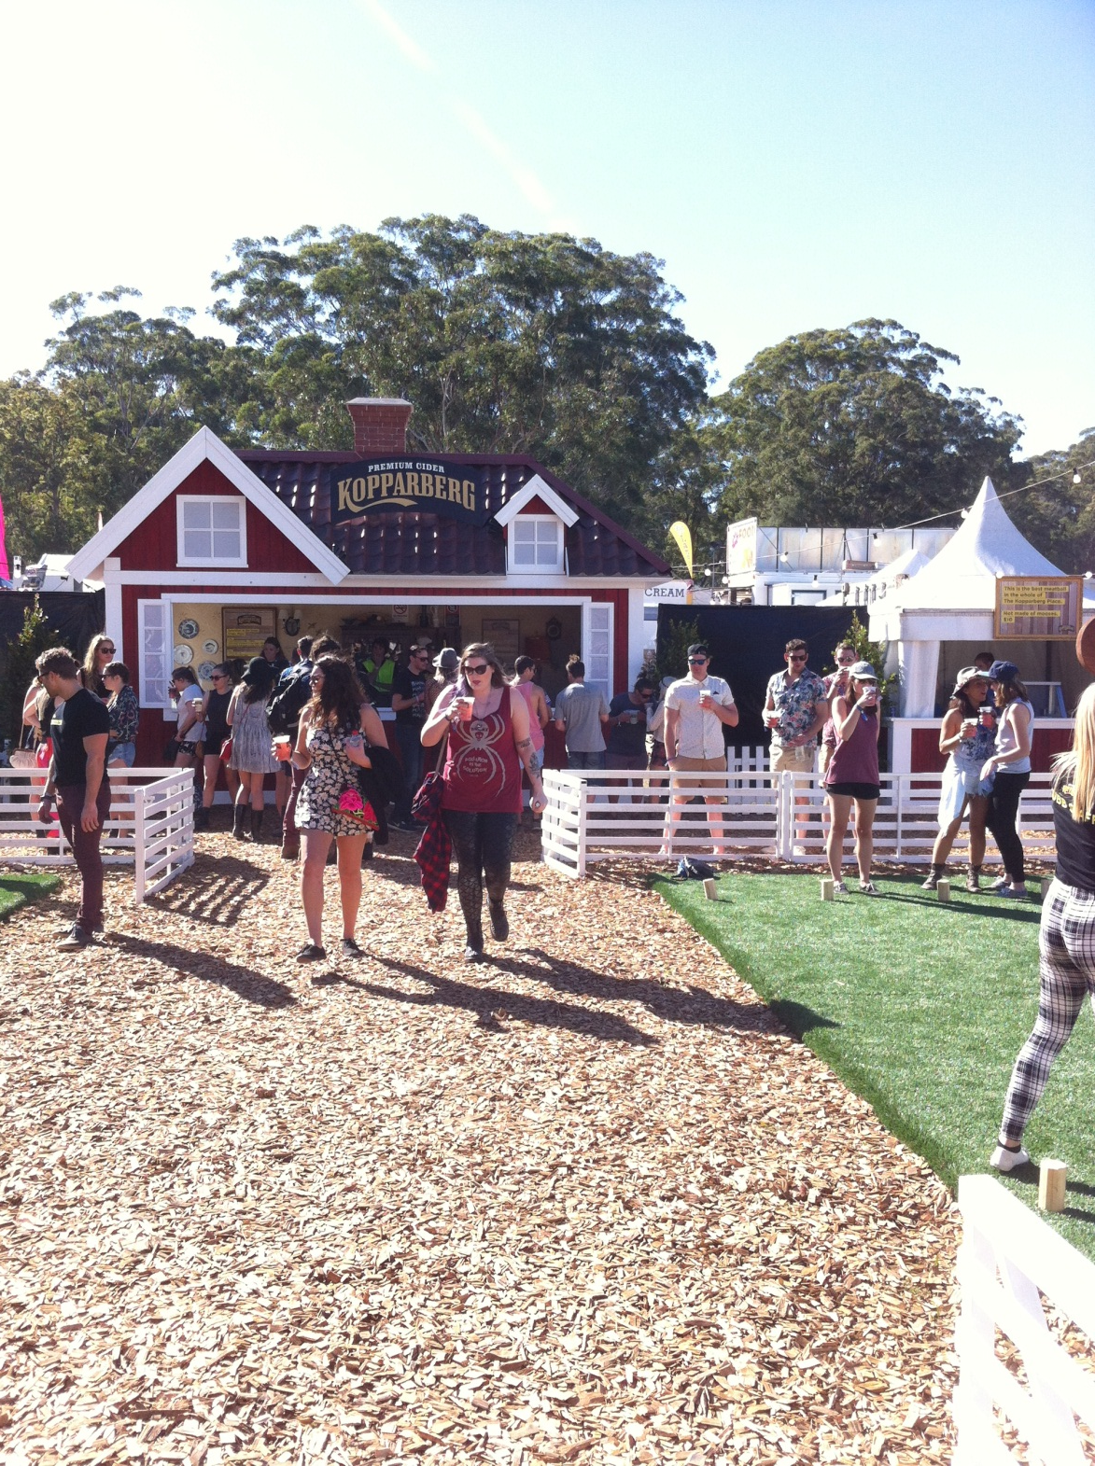

Slide 18
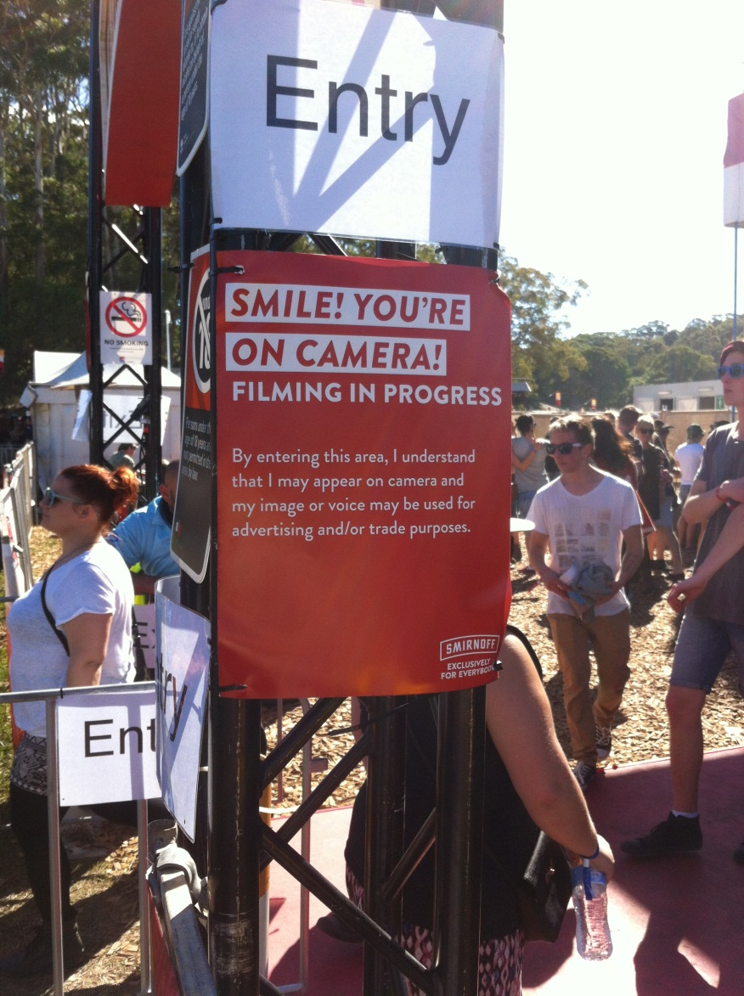
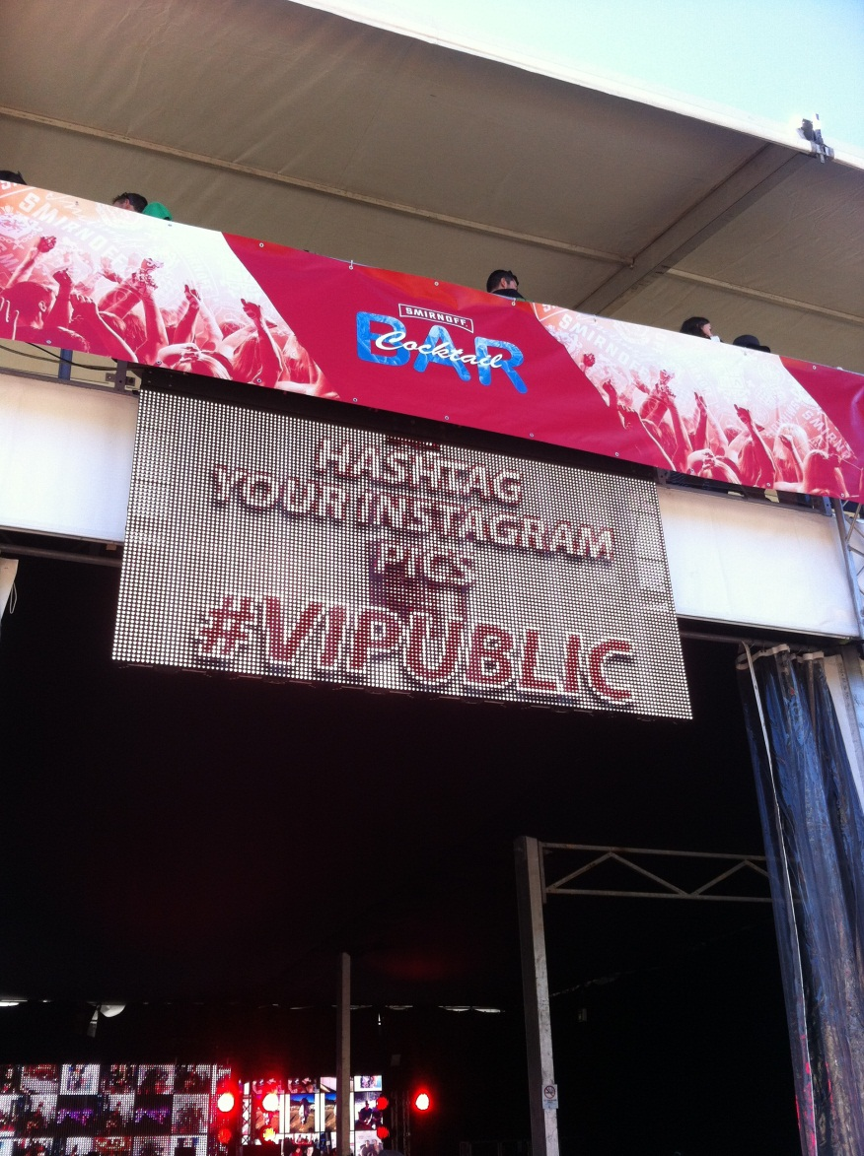

Slide 19
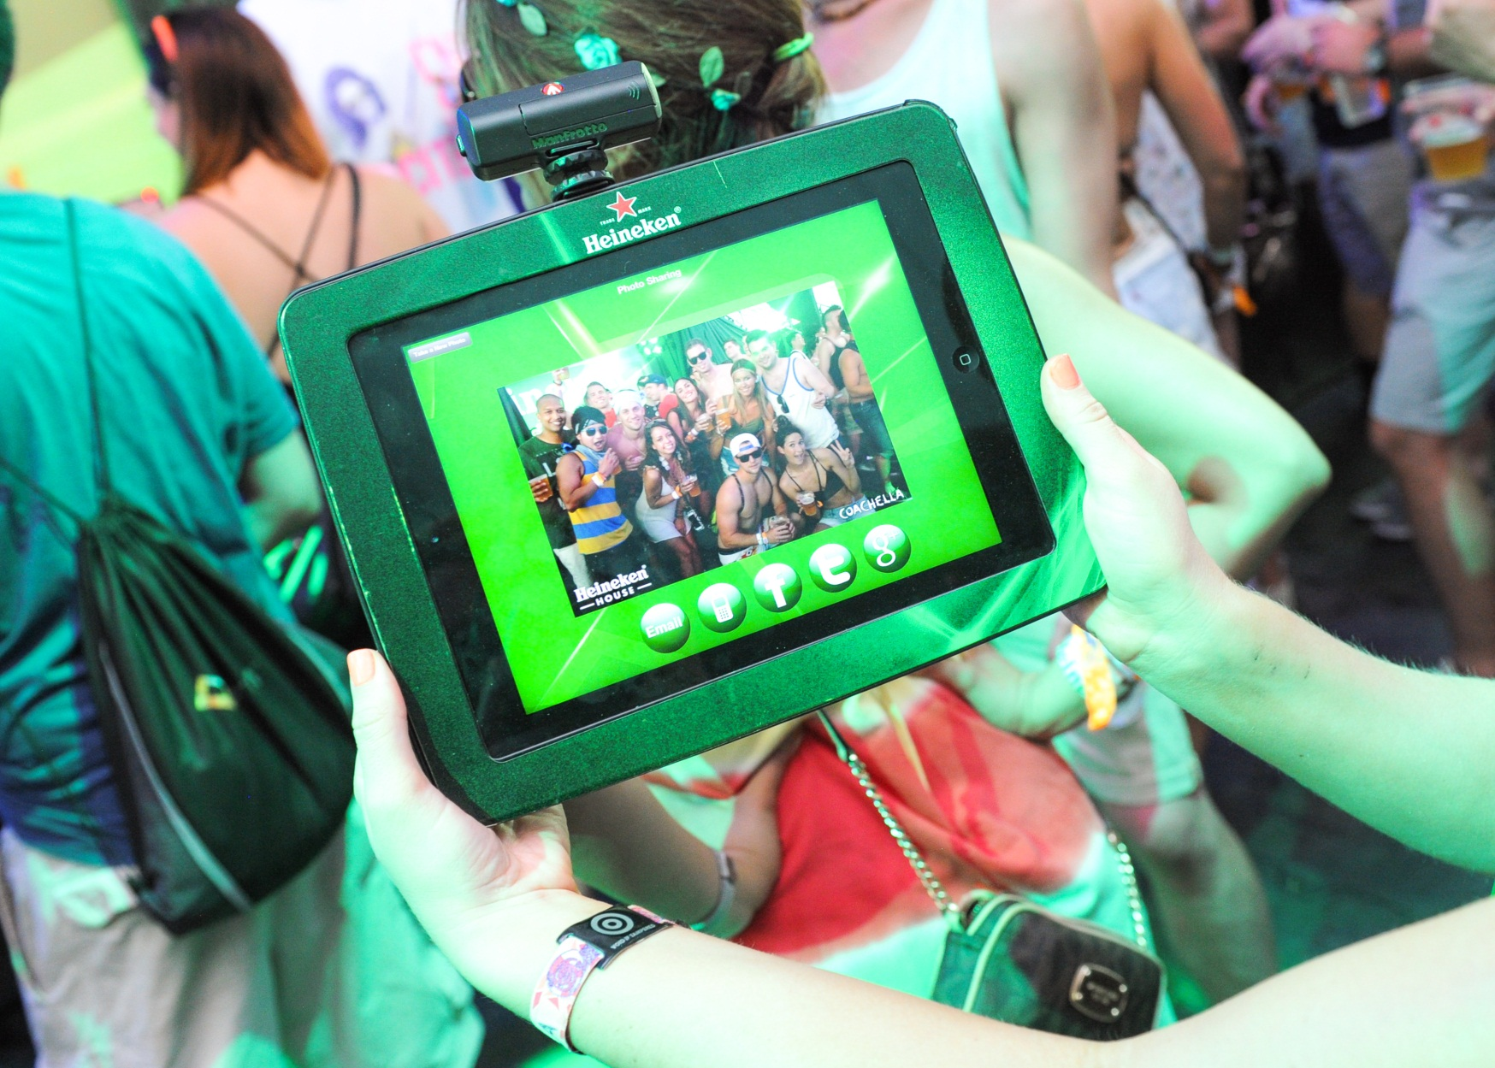

Slide 20
Algorithm.
Activation.
Cultural intermediary.
Gender and identity.

Slide 21
Interplay between people, smartphones, cultural spaces & digital networks.
Embed.
Expand.
Amplify.

Slide 22
More responsive and customised.
More participation and real-world engagement.
More organised at global level.
Less open to public scrutiny.

