Slide 1
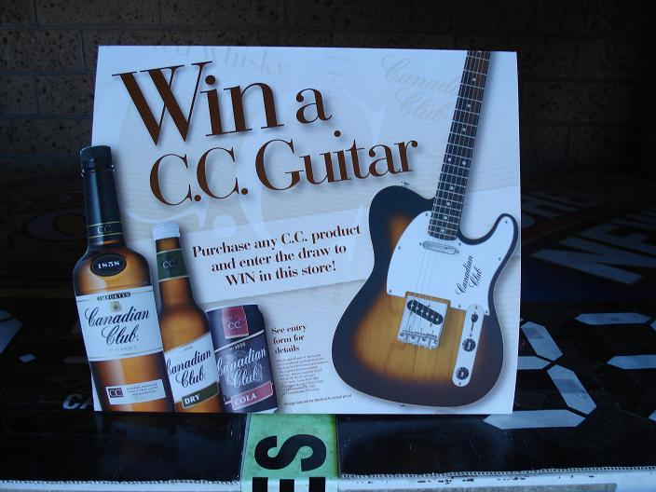
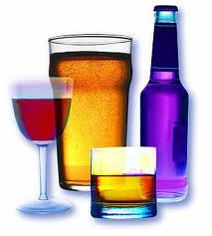
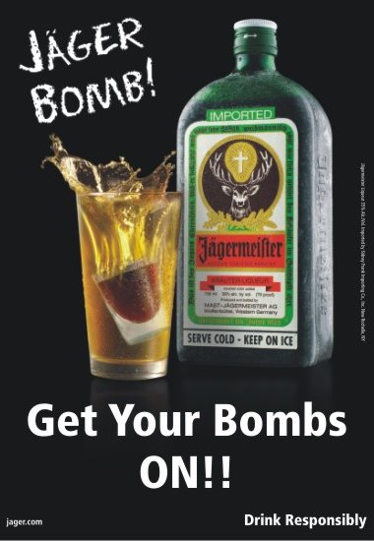
Alcohol marketing in Australia Prof Sandra C Jones Director, Centre for Health and Social Research (CHaSR)

Slide 2
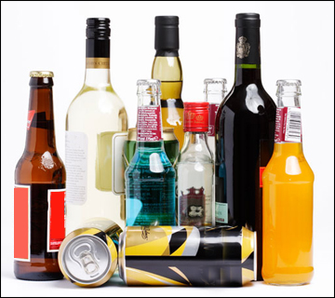
Marketing = not just advertising
Packaging
Labelling
Nutritional content
Other ingredients
Product ‘innovation’
Unit price
Multipack pricing
Sales & ‘specials’
Venue price promotions
Product
Price
Promotion
Place
Outlet density
Opening hours
Online sales
Sporting & cultural events
New distribution channels
Mainstream advertising
Internet marketing
Point-of-sale
Sport sponsorship
Event sponsorship
Product placement

Slide 3
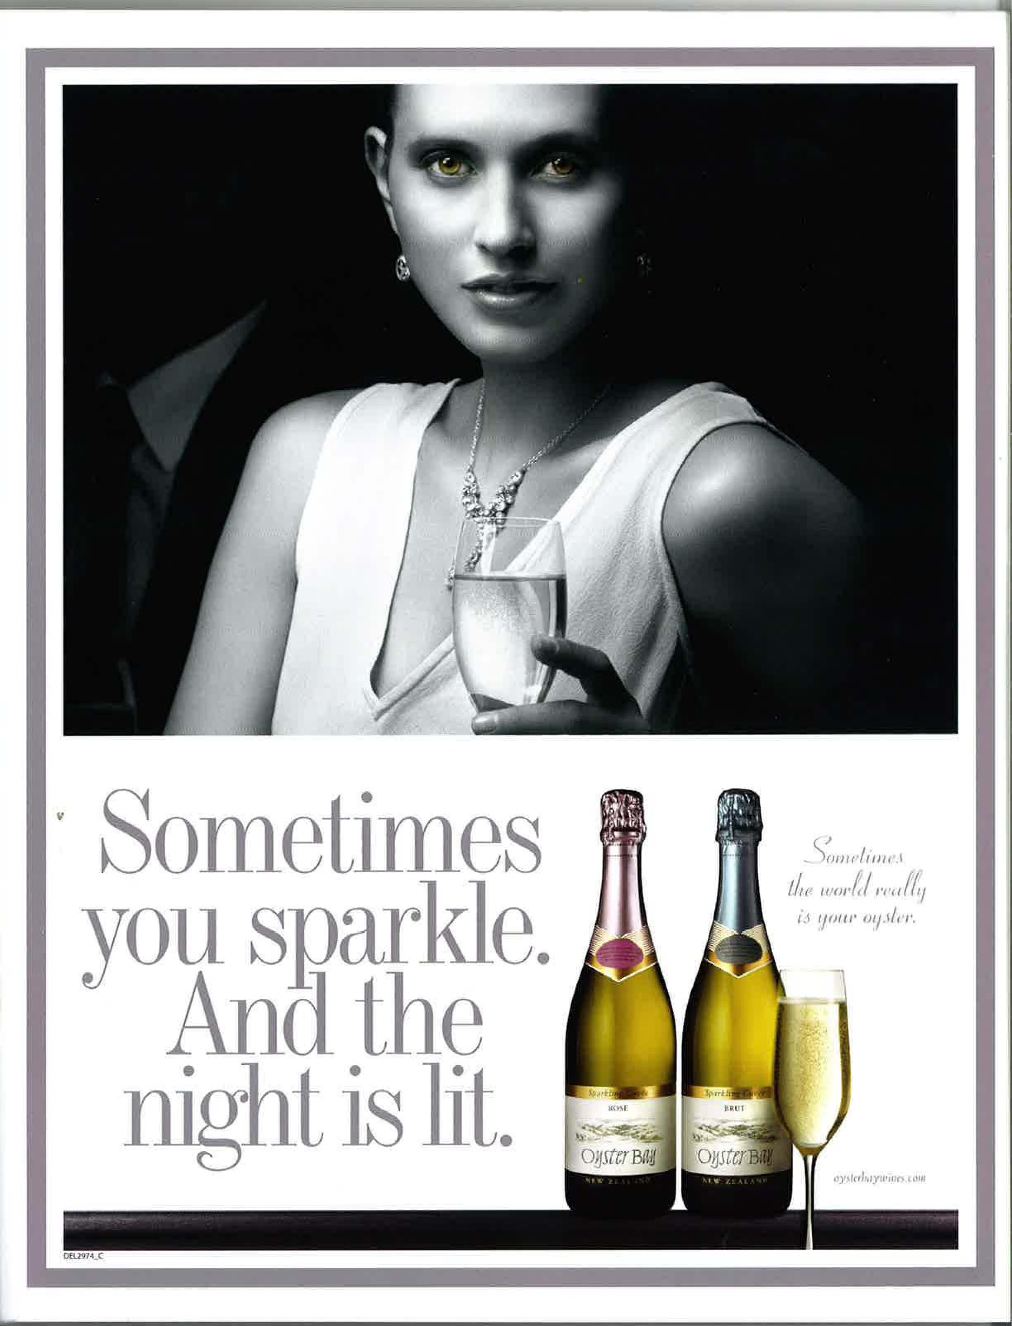
Does exposure to alcohol marketing (advertising) matter?
Evidence from long-term studies in the US:
Snyder et al (2006): for each additional ad a young person saw (over monthly youth average of 23) they drank 1% more; and for each additional $ per capita on alcohol advertising in a local market, young people drank 4% more
Stacy et al (2004): children who viewed more alcohol ads in 7th grade more likely to drink alcohol in the 8th grade
Ellickson et al (2005): exposure to magazine alcohol advertising in 7th grade predicted frequency of drinking in 9th grade

Slide 4
Australian research (Jones & Magee 2011)
Survey of 1,113 NSW adolescents aged 12-17 years
After controlling for age, gender, mother’s drinking, father’s drinking, country of birth, and religion:
Initiation of drinking was associated with exposure to alcohol advertising:
in magazines (AOR=1.69);
in bottleshops and bars (AOR=1.49); and
on promotional items (AOR=1.36)
Recent drinking was significantly associated with exposure to alcohol advertising:
in magazines (AOR=1.54);
on the Internet (AOR=1.36);
and in bars (AOR=1.44)

Slide 5
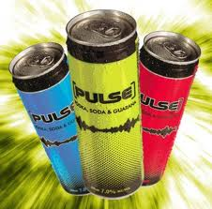
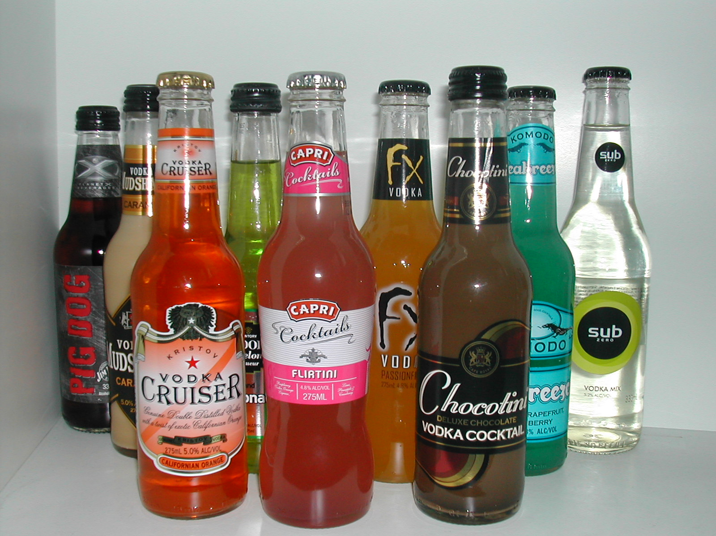
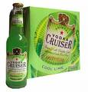
Alcohol marketing in Australia: products and packaging

Slide 6
RTDs – strength/labelling [Jones & Gregory, 2009]
In response to concerns about excessive alcohol consumption, alcohol industry voluntarily introducing new standard drink logos
This labelling change dampened the debate as to whether there should be limits on the alcohol content of standard drinks
We found young people:
had good knowledge of standard drinks & high awareness of standard drink labelling
used this information to increase or even maximize consumption, and get better ‘value for money’
You don’t have to drink as much liquid and stuff. You’re getting drunk but you don’t have to drink a huge quantity.
It’s useful when you’re drinking because you look at the amount of standard drinks and you divide it by the dollar.

Slide 7
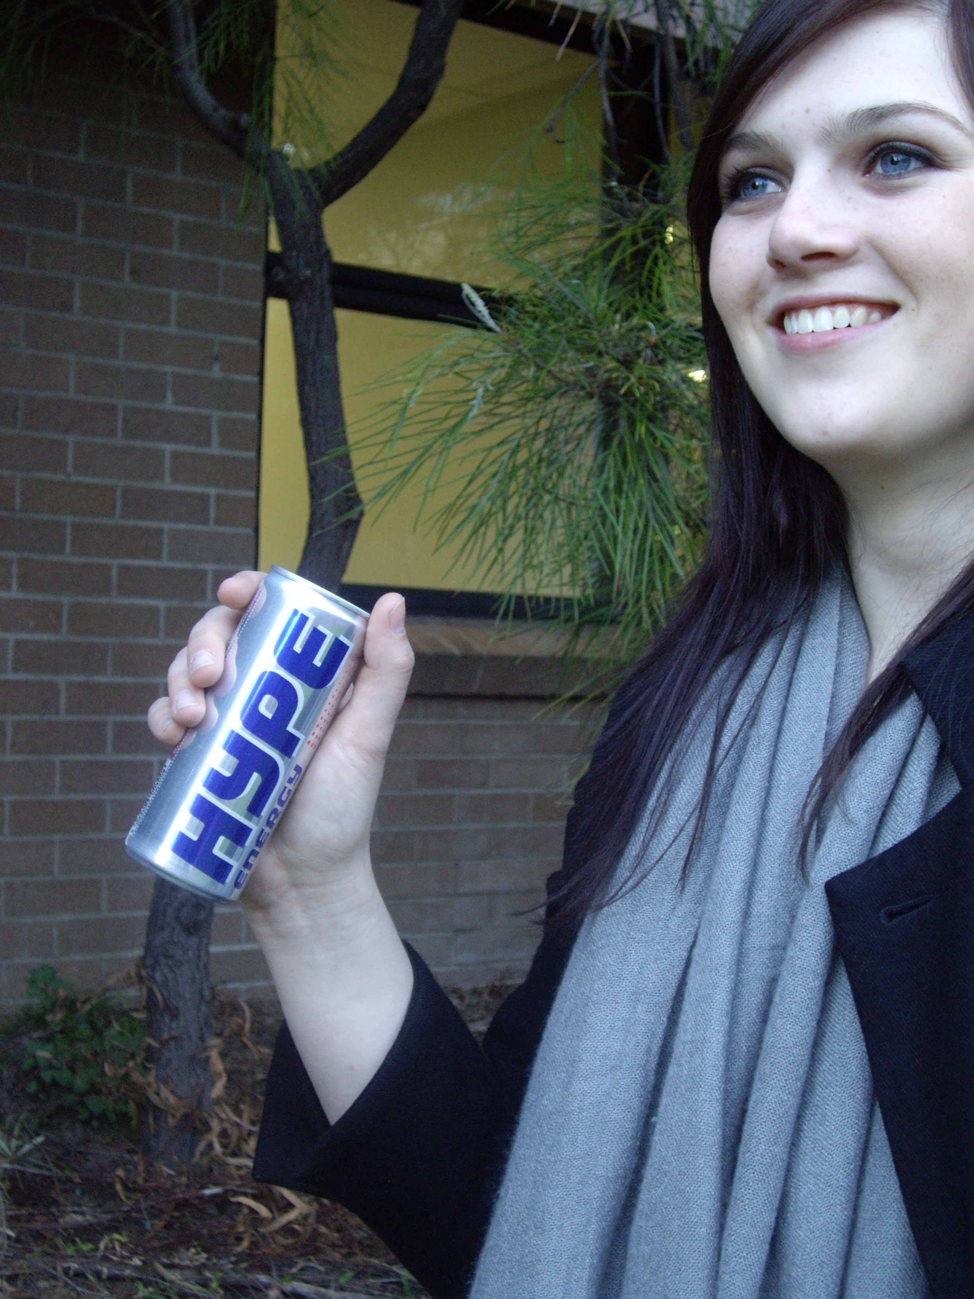
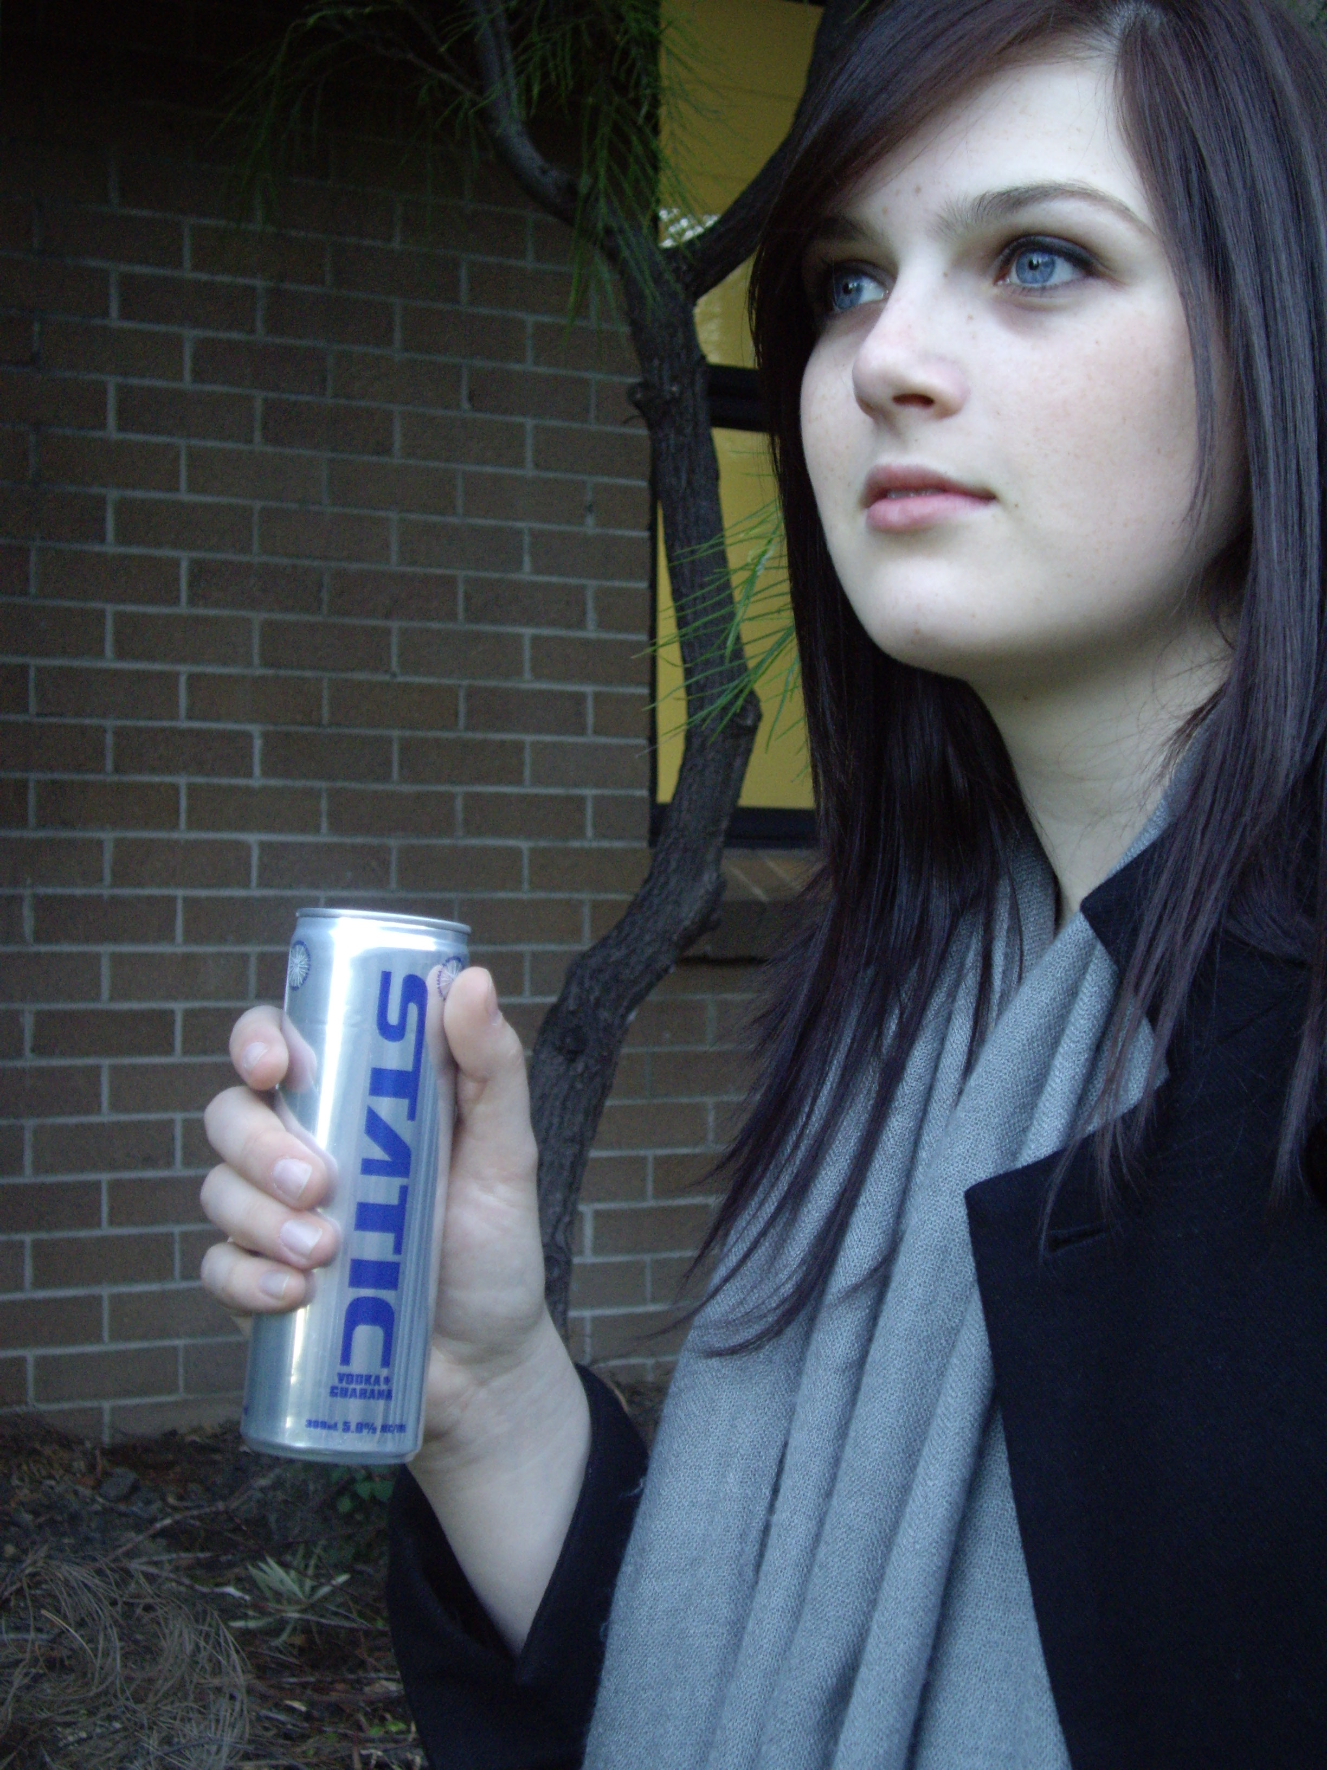
Alcohol energy drinks [Jones, Barrie & Berry, 2011; Jones, 2011]
Alcohol-energy drinks (AEDs) combine alcohol, soft drinks, and ingredients such as caffeine and guarana
AEDs are sold for approximately the same price as non-alcoholic energy drinks and are packaged to look like common soft drinks
Survey of 1,263 12-17 year olds:
38% said they were more likely to choose a product that included energy drinks
43% said they would be more likely to purchase a product if it looked similar to a soft drink (females more than males, and 12-14yo more than 15-17yo)
“you don’t get as tired…It’s like coke really…like fizzy vodka”
(Male, 15-17, Sydney)
“You pick it up thinking it’s a Red Bull. Wouldn’t know it had alcohol in it until you read the can”
(Female, 12-14, Sydney)

Slide 8
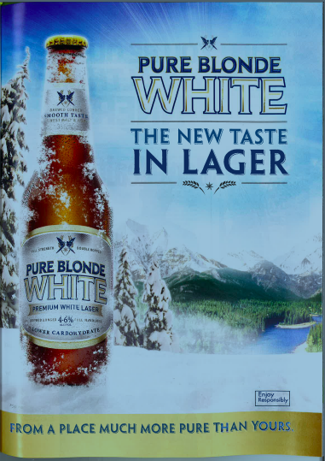
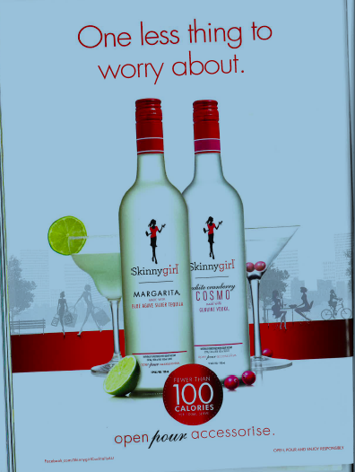
“Healthy” alcohol products
“Lower carbohydrate”
“Fewer than 100 calories”

Slide 9
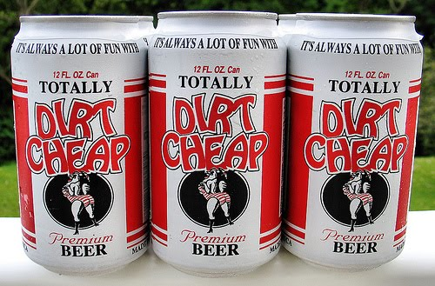
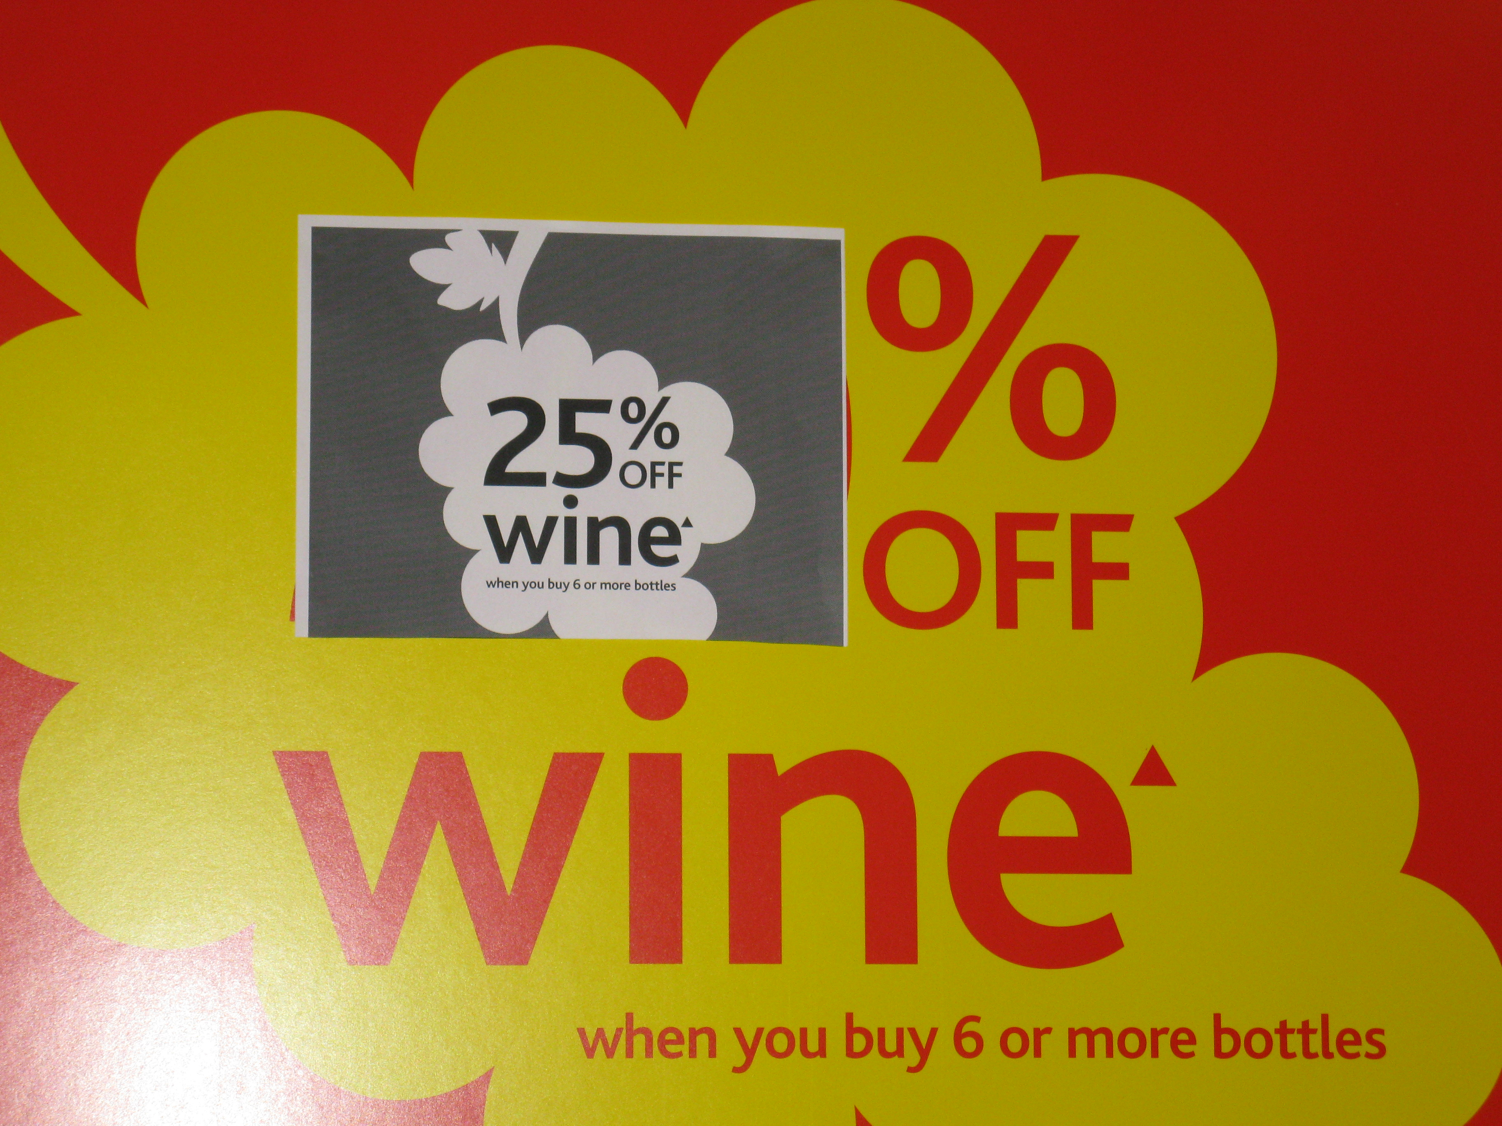
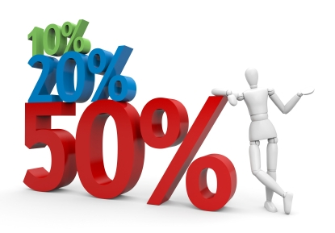
Alcohol marketing in Australia: price

Slide 10
Audit of RTD products in NSW [Jones & Barrie, 2010]
Across 52 bottle shops audited, 150 individual RTD alcohol products were identified
Bourbon and whiskey based RTD products dominated the market (67 out of 150 products), followed by vodka-based (35), rum-based (15), RTD shots (11), and tequila-based (4)
Alcohol volume ranged from 4.8% to 9.0%; SD ranged from 1.0 to 2.7 SD per unit
When purchased in multi-packs, the price dropped to as low as $1.95 per SD
Pricing of multipacks makes it only marginally more expensive to purchase a 4-pack of RTDs than 3 individual units; and significantly cheaper to purchase a 6-pack than 5 individual units

Slide 11
Point-of-sale alcohol marketing
Audit of 24 alcohol outlets – 12 in Perth metro area & 12 in Sydney metro [Jones, Barrie, Robinson, Allsop & Chikritzhs, 2012]:
A total of 431 POS promotions identified (average of 36 per store)
How much alcohol to participate?
beer – average 23.3 standard drinks (SD)
Spirits - 24.4 SD
RTD - 14.12 SD
wine - 23.0 SD
(Would you be tempted to drink more that night?) Oh yeah.
For sure.
You only went in to buy one.
When we go to parties if there’s heaps of alcohol, we’ll drink heaps of alcohol.
When you’ve got it there in front of you, you keep pushing yourself, oh another one.
(16-17yo females, Sydney)

Slide 12
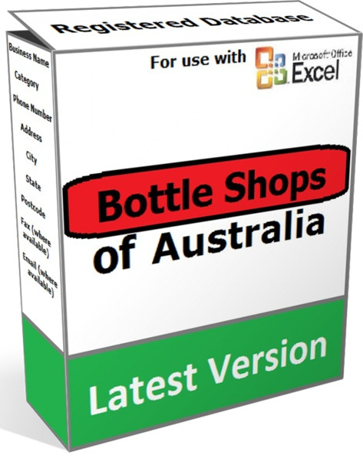
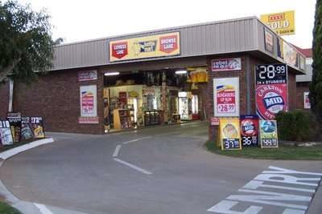
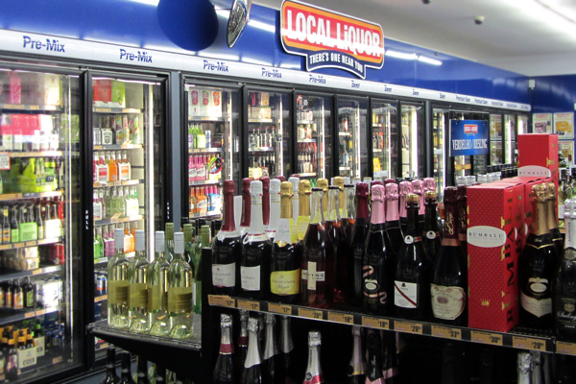
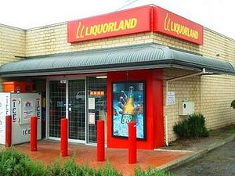
Alcohol marketing in Australia: place

Slide 13
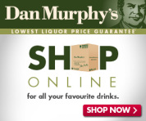
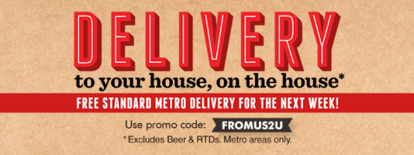
Alcohol is increasingly available to (young) people – and this is associated with increased exposure to marketing messages:
pubs and clubs
bottleshops (and delivery services)
supermarkets (and shopper dockets)
online (including group buying sites)

Slide 14
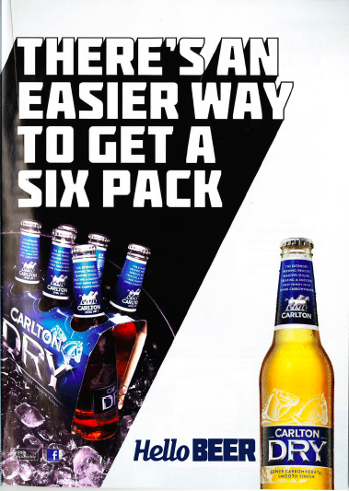
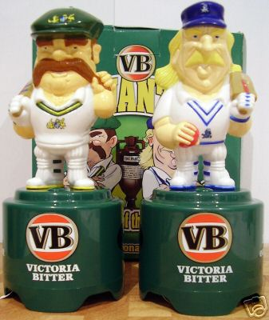
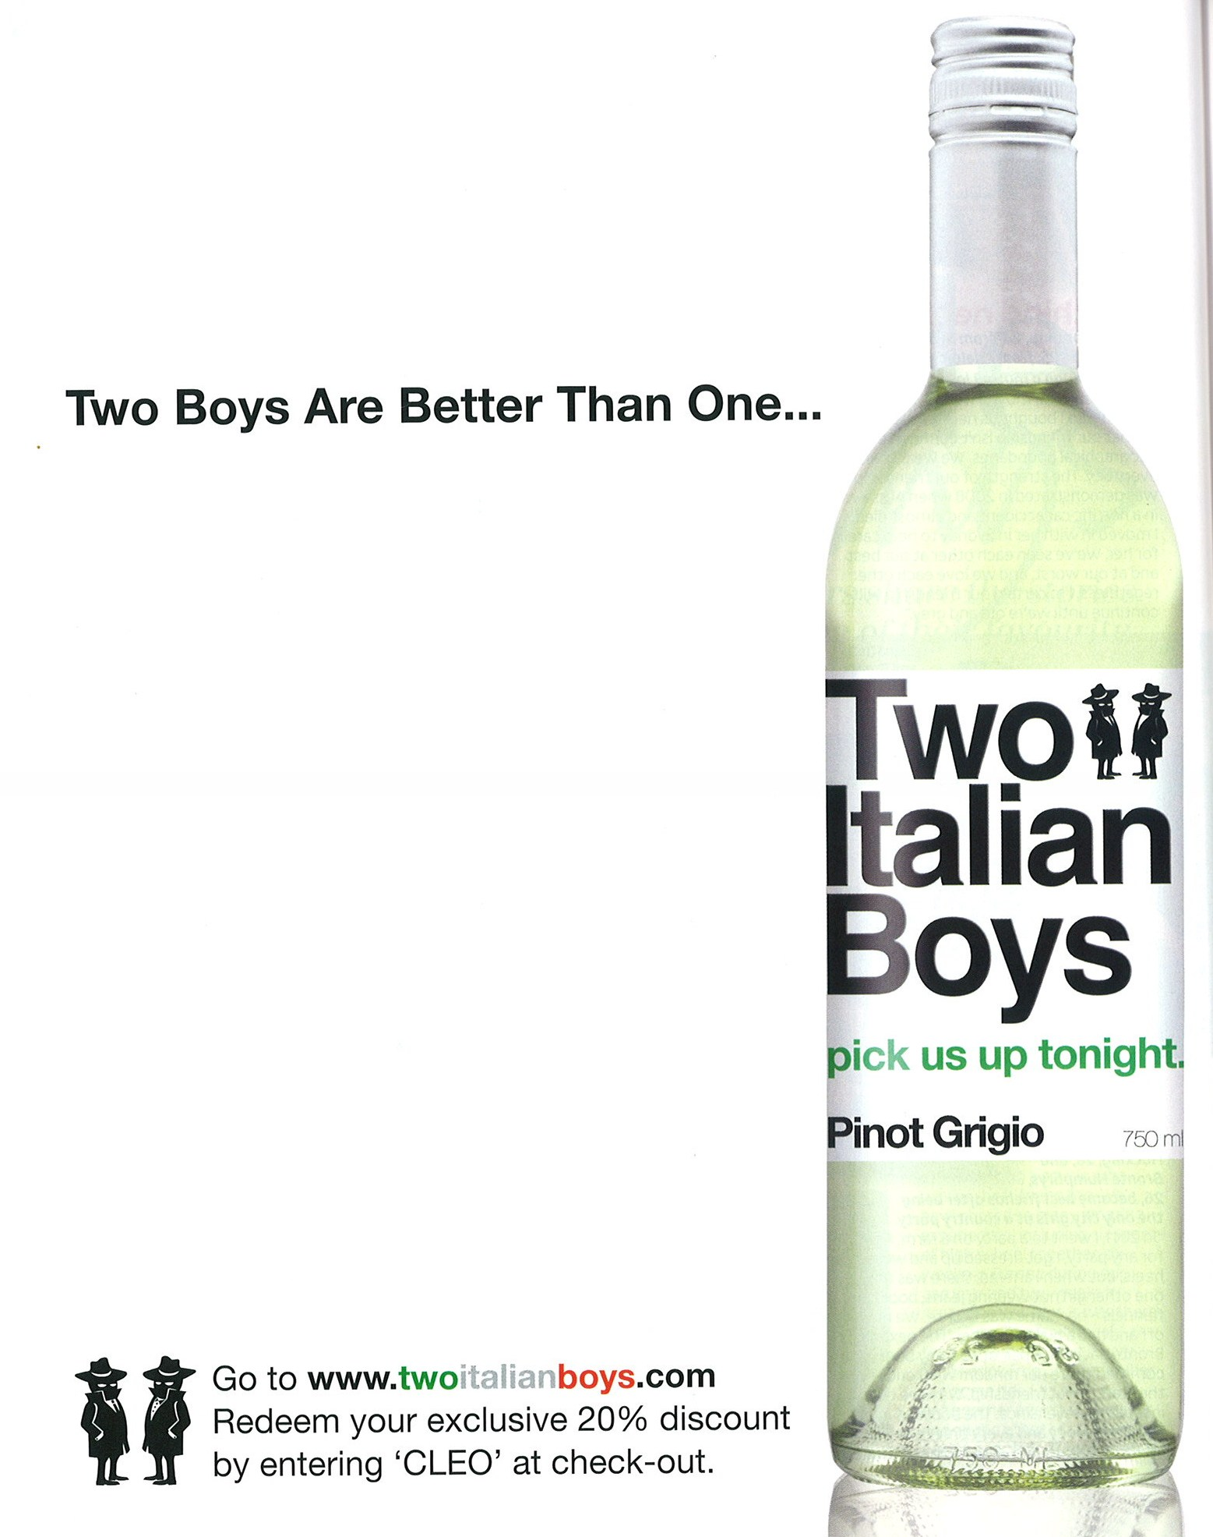
Alcohol marketing in Australia: promotion

Slide 15
‘Mainstream’ advertising – print and broadcast
Adolescent & young people’s responses to alcohol advertising [Jones, Gregory & Munro, 2010]
110 secondary school students aged 15-18; and 177 people aged 18-24
each saw two (of 12) alcohol advertisements
more than half perceived that the advertisement viewed implied that drinking the advertised product would:
make them more sociable and outgoing
help them have a great time (particularly underage respondents)
help them fit in
help them feel more confident
help them feel less nervous; and
(slightly less than half) that it would help them succeed with the opposite sex and make them feel more attractive

Slide 16
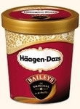
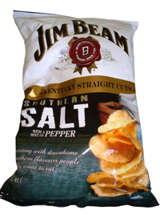
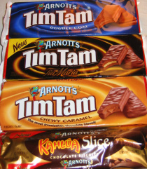
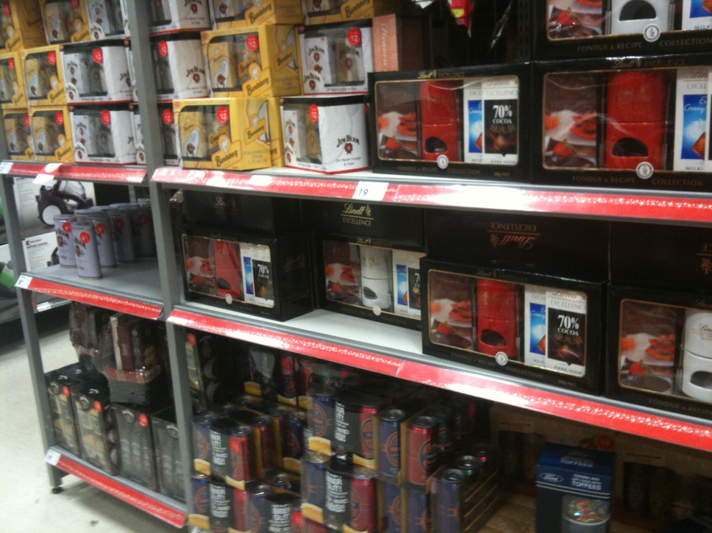
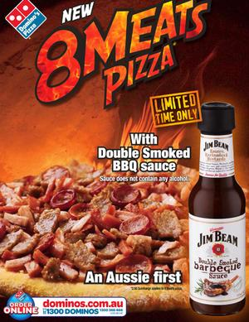
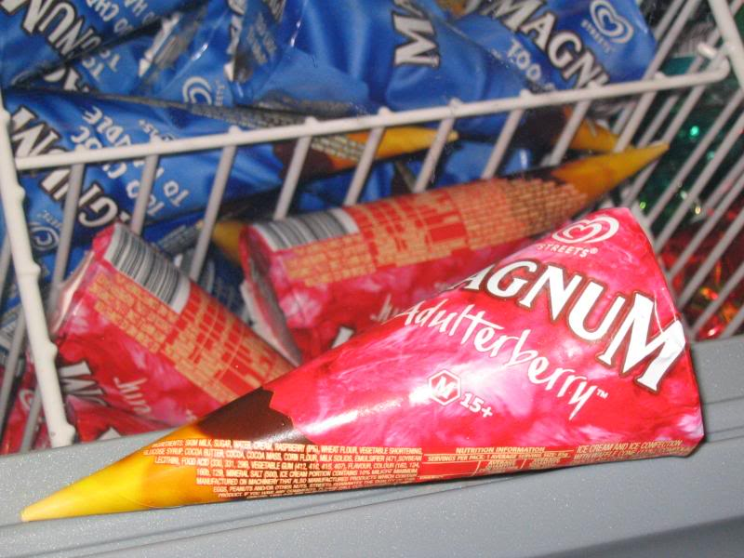
Alcohol branded merchandise
Increasingly, we see POS alcohol promotions that are offered outside of alcohol outlets (i.e., POS for other products)
This started with clothing, hats, drinking paraphernalia
……then sporting equipment and team/code merchandise
……then branded alcohol-flavoured food products (chips, chocolates, pizza, ice-cream…)

Slide 17
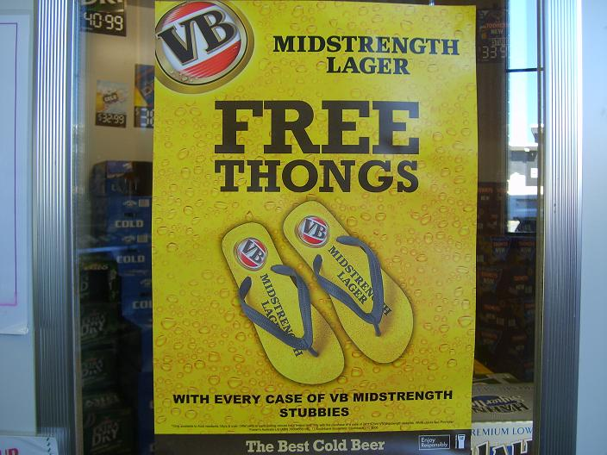
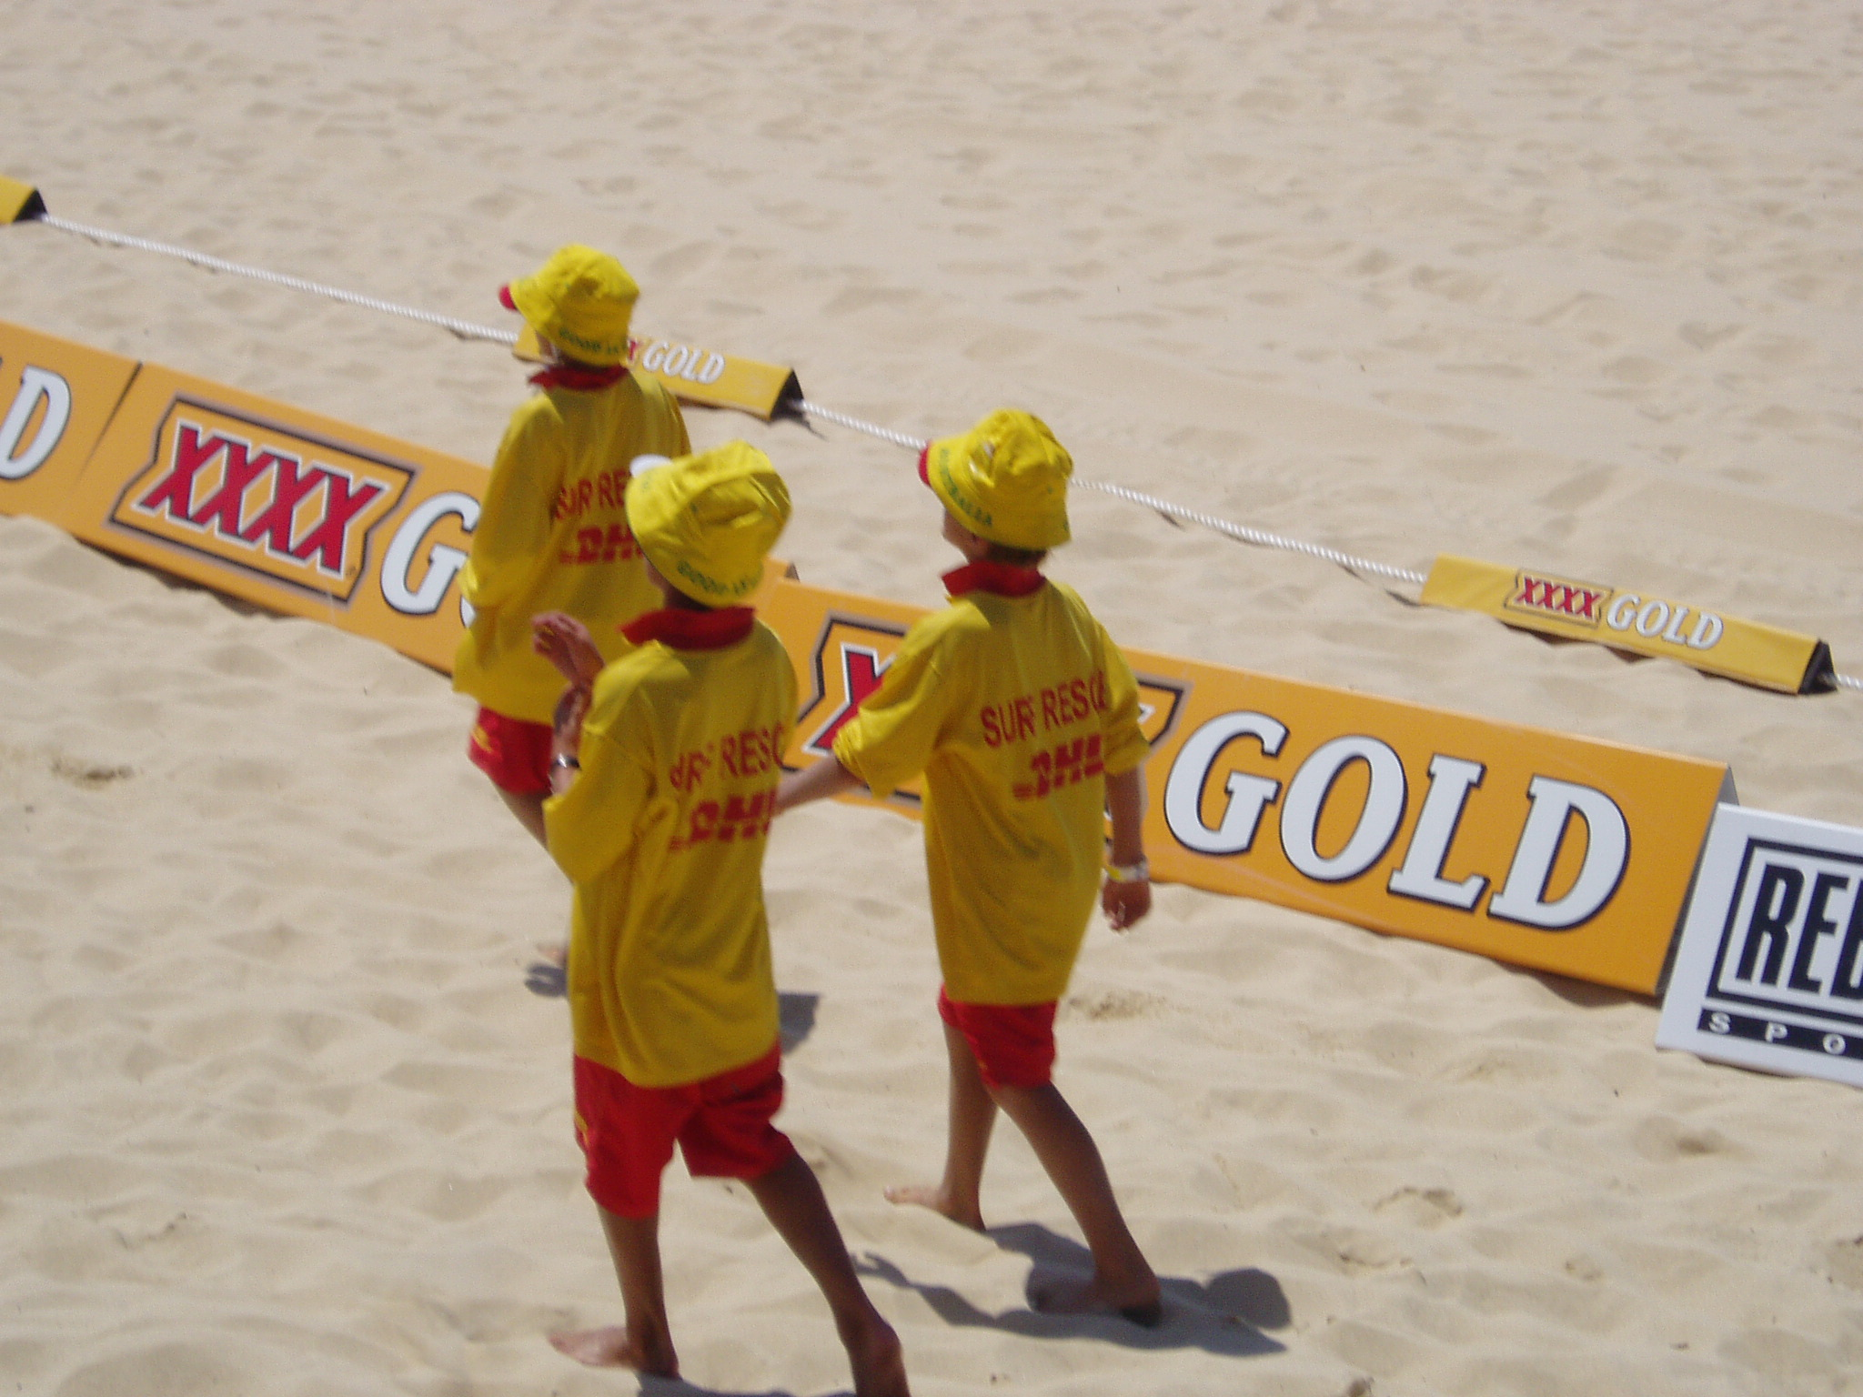
We surveyed 216 NSW secondary school students (majority aged 13-15 years) about ownership of ABM:
34.8% owned a cup or bottle holder with alcohol branding
25.7% a hat
19.0% a t-shirt
18.6% a bag or cooler
10.0% sports equipment
5.7% other forms of ABM
Association between ABM ownership and drinking initiation, perceived peer alcohol consumption, and believing friends would think it was a good idea for them to drink alcohol

Slide 18
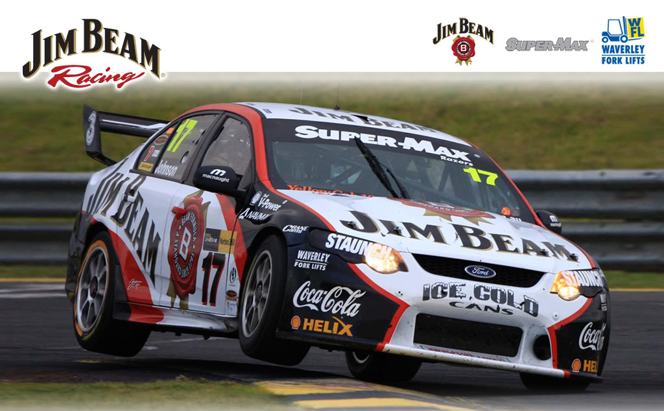
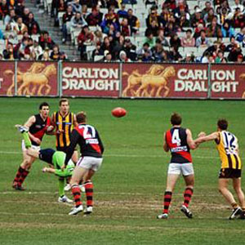
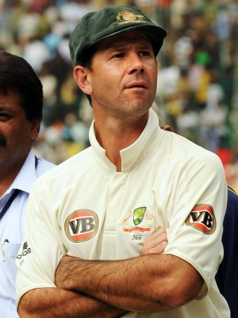
Alcohol marketing in, on, at and around sports
Audit of broadcasts of 2012 NRL and AFL Grand Finals [Jones, Barrie, Chapman & Davoren, 2013]
Considering all forms of alcohol marketing:
NRL: average of 530 incidents (30 minutes, 40 seconds) per match
AFL: average of 244 incidents (20 minutes) per match
Alcohol ‘advertisements’ made up only 5% of the alcohol marketing during these sporting broadcasts
Qualitative study with grade 5 & 6 primary school students [Jones, Phillipson & Barrie, 2010]
High awareness of alcohol sponsors &alcohol brands advertised during telecasts
Associate alcohol products with sport, being male, and positive personal characteristics and outcomes

Slide 19
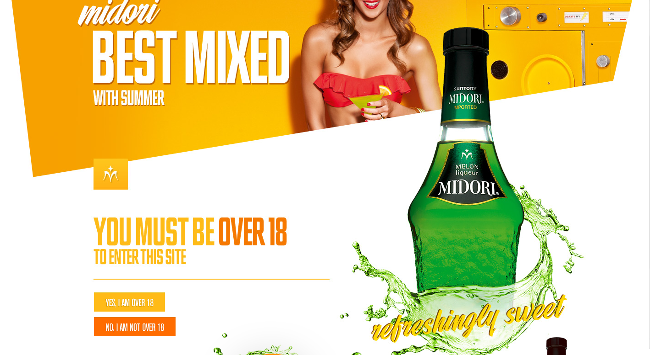
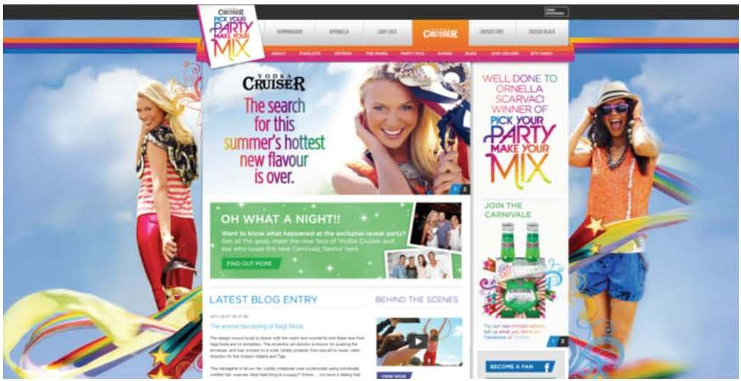
Alcohol marketing on the Internet
Audit of 25 alcohol company official brand websites [Jones, Thom, Davoren & Barrie, 2010]
18 of the 25 sites had direct links to their Facebook pages, and 11 invited their ‘friends’ to follow them on Twitter
Six of the sites encouraged upload photos and other materials directly onto the main brand/product website
Website entry pages and commercial filters were universally ineffective in blocking underage access (Jones, Thom, Davoren & Barrie 2013)

Slide 20
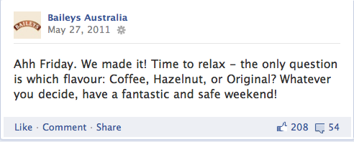
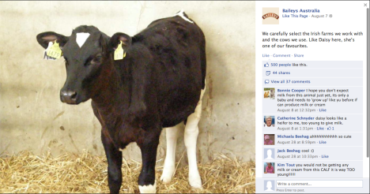
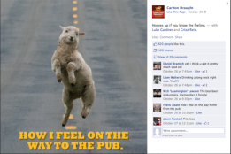
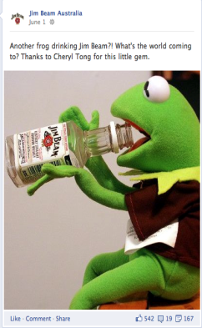
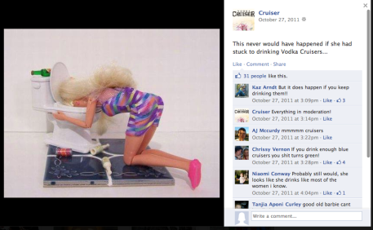
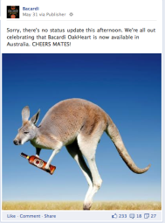
Alcohol marketing on social media

Slide 21
Questions?
@ProfSCJones Sandra Jones Sandra.Jones@acu.edu.au

