Slide 1
AMA National Alcohol Summit Addressing Alcohol Related Harm: Local Government Perspective
Kate O’Connor
Manager City Business and Safety
City of Sydney

Slide 2
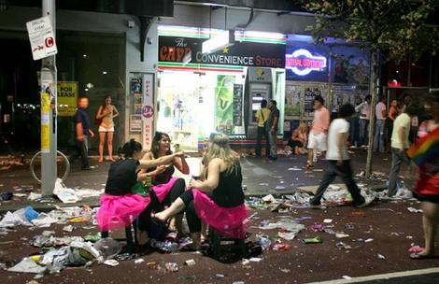
Role of Local Government
Public space management
Safe communities
Cities at night for everyone
Notes:
Costs of managing NTE = approx. $30million to City of Sydney in 2009
Value of NTE = $15.1billion in 2009, food, drink and entertainment – food biggest driver
In partnership with State Government, local government is responsible for creating and maintaining safe communities
Recent survey of residents, workers and visitors in City of Sydney, highlighted alcohol related violence as one of the main concerns for people in terms of safety
Consultation to develop the City’s OPEN Sydney strategy – over 5000 visitors to the consultation website – people want more from their city at night, safety is key, but so is the diversity of offering

Slide 3
Responses include:
- Precinct-based action plans
- Diverse night time events
- Research and consultation
- Planning controls
- Collaborative working
Notes:
City of Sydney responses:
Precinct ambassadors, CCTV cameras, Alcohol free zones, Upgraded lighting to LED, Compliance and enforcement, Portable urinals and toilets, 24/7 cleansings crews, VMS signage with information for public, Late night tourist kiosks
Diverse events at night attract a wide range of people into the City at night, for example New Years Eve and Chinese New Year and smaller events such as the BEAMS festival.
Working closely with NSW Police to address issues relating to excessive consumption of alcohol, creating AFZs, developing actions plans to address community issues.
City’s Late Night Trading Development Control Plan.
Research including Late Night Management Areas Research, national research into the value of the Australian NTE

Slide 4
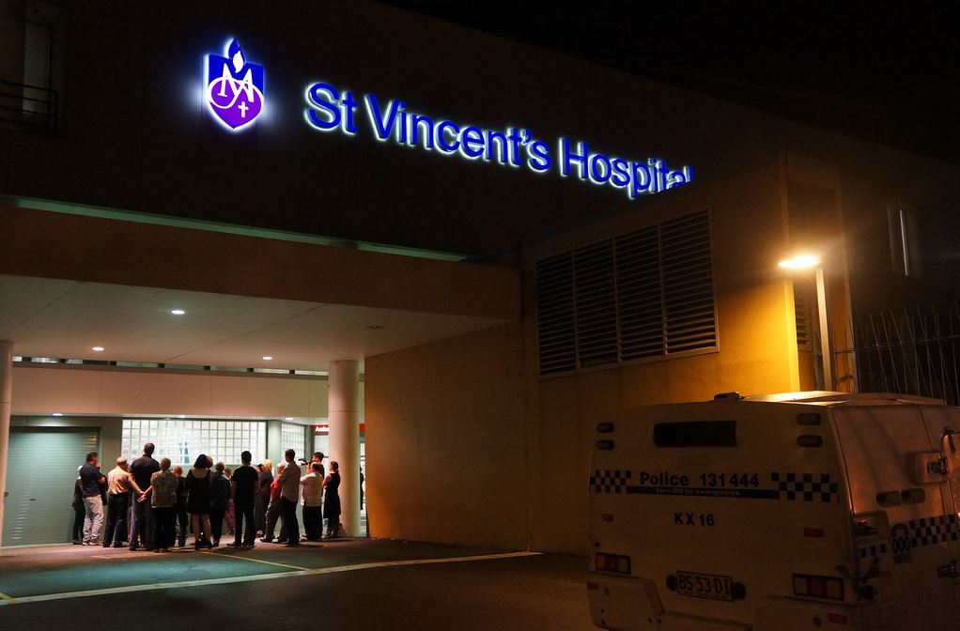
Areas for action
Addressing outlet density, saturation and cumulative impact
Improvements to liquor licensing/planning system
Collection of meaningful data
Notes:
Ability for Council’s to refuse a development application based on saturation
Transparency in the liquor licensing process – a joint committee (state and local) which considers contentious DA/liquor licence applications in an open forum
Consideration given to venues with live music/live performance as a lower risk activity
Data: wholesale alcohol sales data to be collected in NSW, alcohol-related accident and emergency admissions, ambulance call-outs etc.
Reference to the Citizen’s Jury recommendations.

