Slide 1
Alcohol Harm and Violence: Where EDs Meets the Streets
Dr Diana Egerton-Warburton
Chair, ACEM Public Health Committee
Lead Researcher, Alcohol Harm in EDs Project

Slide 2
Where EDs Meets the Streets
EDs are not required to systematically screen and submit alcohol prevalence data for state/territory/national patient data sets.
Alcohol-related presentations to EDs are underestimated and data is incomplete.
2012: “ACEM Working Together: Emergency Medicine, Disaster and Public Health Consensus Meeting” identified alcohol harm in EDs as a priority public health issue. ACEM funding for pilot.
2013: ACEM received funding from the Australian Government for a two-year project to quantify alcohol-related harm presenting to emergency departments in Australia and New Zealand.

Slide 3
Alcohol Harm in ED Aims
Bi-national prospective data of alcohol harm presenting to EDs in Australia and New Zealand
Lead an informed community discussion about the harms related to alcohol use and its impact on EDs
Provide an evidence base to advocate for government policy change.

Slide 4
Project
Two snapshot (point prevalence) surveys
Media campaign
A survey of ED clinical staff perceptions of alcohol–related presentations
A seven-day continuous survey of alcohol-related presentations in nine EDs across Australasia

Slide 5
Snapshot survey 2013
A point-prevalence survey was conducted in 106 EDs in Australia and New Zealand at 2am on 14 December 2013
Snapshot of the number of direct and indirect alcohol-related presentations in the waiting room, ED and short stay or observation units
Results:
14% of presentations in Australia were alcohol-related
18% in New Zealand were alcohol-related
All regions had EDs with 1 in 3 alcohol-affected patients.
Media campaign
AMA, NAAA, PHAA
> 8 million audience

Slide 6
Enough is Enough: Alcohol Harm in EDs 2014 Survey
Over 2000 emergency doctors and nurses were surveyed on their perceptions of alcohol-related presentations in their ED
Largest survey of its kind to be undertaken in Australia and New Zealand
Survey confirms that alcohol-affected patients have a serious impact on staff and other patients in EDs
Survey findings will be launched at St Vincent’s Hospital, Melbourne on 6 November
If you would like to attend the event, email: angela.wadsworth@acem.org.au

Slide 7
Alcohol Harm in Emergency Departments
Seven-day survey
A seven-day survey of alcohol-related presentations in December 2014
Nine EDs in Australia and New Zealand
Will generate a rich data set:
Direct and indirect harm
Percentage of alcohol-related presentations over a one-week period
The range of alcohol-related presentations
Demographics of alcohol-affected patients
Flow on effects to the ED
Drinking patterns prior to ED presentation.
AUDIT scores
Validate snapshot methodology

Slide 8
‘Although BI heads the list of effective and cost–effective evidence based treatment methods, commonly less than 10% of the population at risk of becoming hazardous and harmful drinkers are identified and less than 5% of those who could benefit are offered brief advice.’ (WHO, 2009).

Slide 9
Alcohol SBIRT in Emergency Departments
Recent Australian research suggest feasible and effective with resources
ED identified by WHO as ‘ideal’ for BI
High rate of harm and risky drinking but low dependency
Teachable moment
Impact is product of reach x efficiency
5.7 million adults and adolescents present annually to Australasian ED
10% alcohol harm and 45% hazardous drinking
Potential audience of about 2.5 million
Screen alone may be enough of a ‘BI’

Slide 10
Alcohol policy
ACEM calls on governments in Australia and New Zealand to:
1. Add emergency department alcohol-related presentations to patient data sets
Mandatory collection of this data would provide:
A clearer picture of the extent of alcohol-related presentations to EDs
An evidence base to inform policy decisions
A framework to enable evaluation of legislative measures introduced to address alcohol harm.

Slide 11
Alcohol policy
2. A screening, brief intervention and referral for treatment (‘Brief Intervention’) program for alcohol-affected patients in emergency departments
ACEM would like to trial and evaluate an evidence-based Brief Intervention program designed for Australasian emergency departments.

Slide 12
Alcohol policy
3. Address availability and alcohol-related violence
Whole of community approach including:
Introduce 3am as the latest time for serving alcohol in pubs and clubs
Maintain and extend the freeze on granting new late night licenses
Introduce 10pm as the latest time for packaged liquor sales

Slide 13
Alcohol policy
4. Control the advertising and promotion of alcohol
Young people are regularly exposed to advertisements depicting alcohol consumption as social, fun and inexpensive
We would like to see greater efforts made to protect young audiences up to 25 years from alcohol advertising, and the banning of alcohol sponsorship in sports
Alcohol advertising in Australia is self-regulated by the alcohol and advertising industries. ACEM supports the establishment of an independent regulatory body for alcohol advertising, sponsorship and promotions.

Slide 14
Alcohol policy
5. Tax alcohol products according to their alcohol content, not their price.
Alcohol products in Australia are taxed differently according to type, packaging, alcohol content and cost. The greatest discrepancy in the current system is the wine equalisation tax (WET). Wine is taxed according to its retail price rather than its alcohol content, resulting in cheaper wines attracting far less tax. ACEM supports measures to tax alcohol products according to their alcohol content.

Slide 15
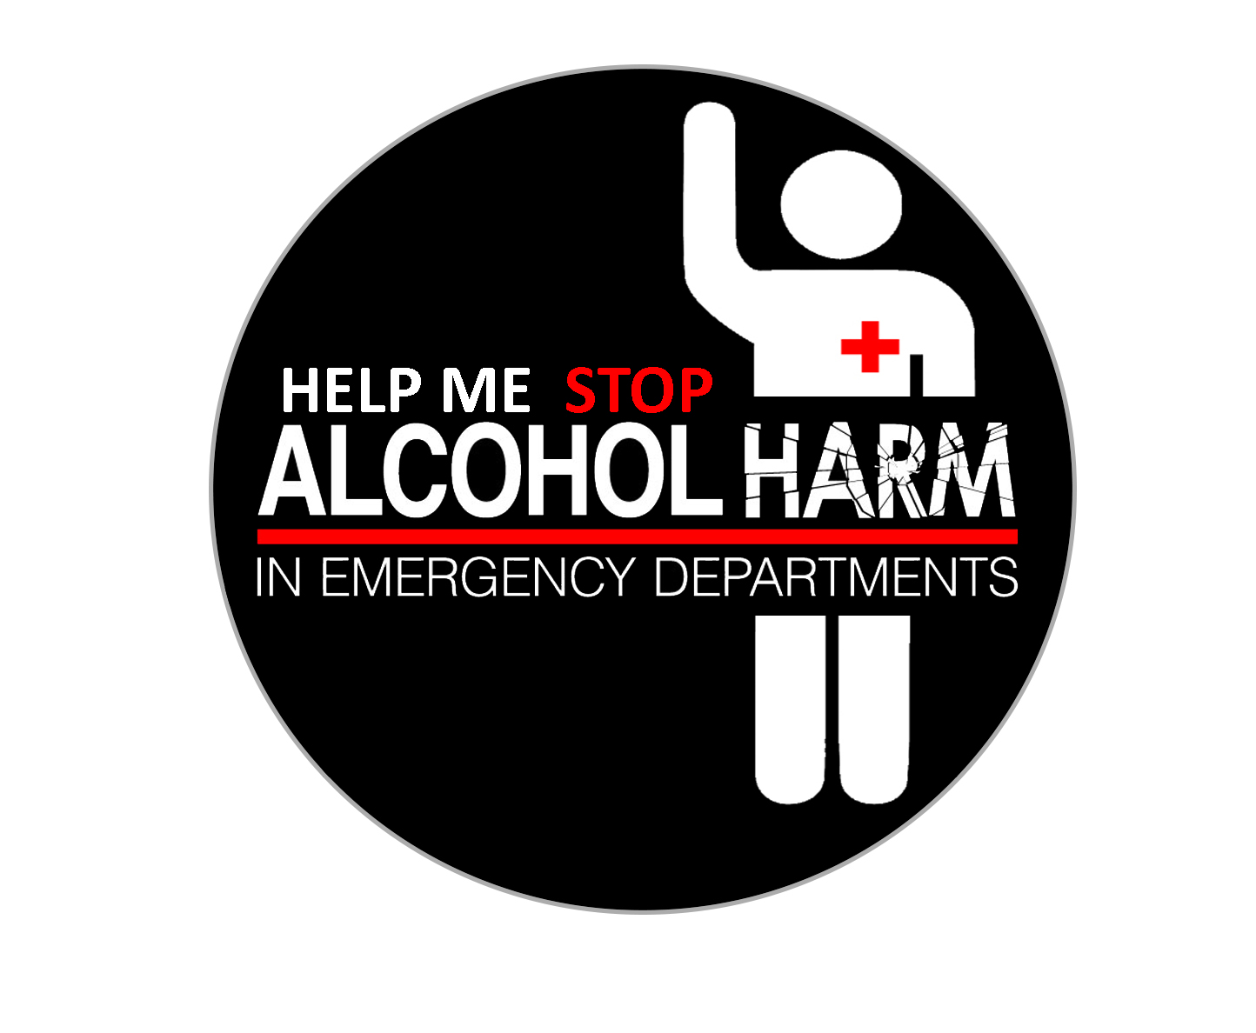
Diana Egerton-Warburton
dianaew@me.com
Twitter: @First_do_noharm

